Slide 1
Sylvin H. Müller-Navarra (1), Diederik Haalman (2) and Klaus Knüpffer (3)

Slide 2
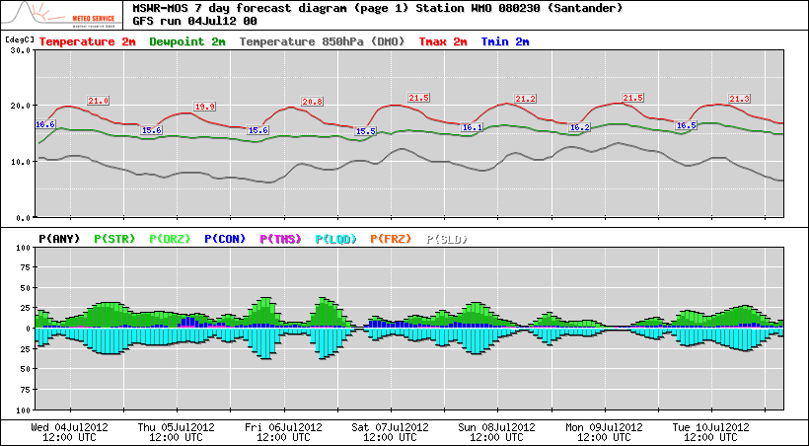
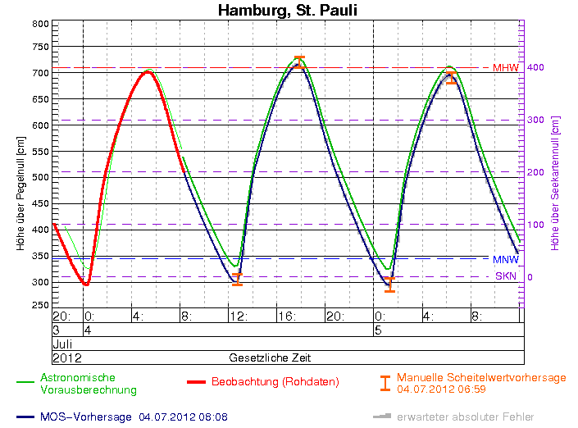
Model Output Statistics (MOS) forecast examples
weather (Santander):
water level (Hamburg, St.Pauli):

Slide 3
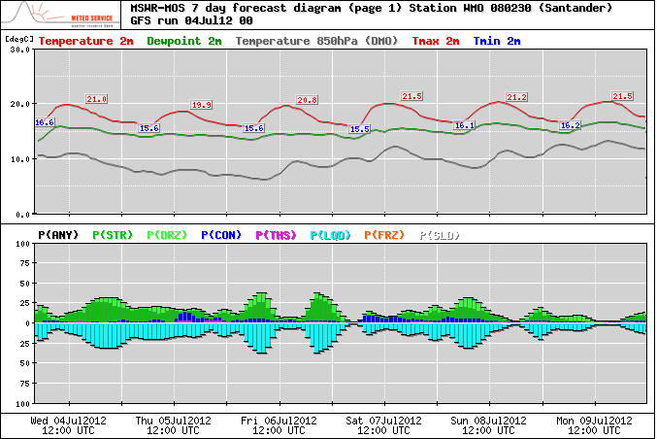
Model Output Statistics (MOS) forecast examples
weather (Santander):
water level (Hamburg, St.Pauli):

Slide 4
MOS = Model Output Statistics (stat. Post-Processing)
DMO = Direct Model Output (num. model: based on physics)
For most observed weather elements and now also for water level forecasts:
RV(MOS,DMO)* = 50%
*RV(MOS,DMO): Reduction of (error) variance of MOS as compared to DMO:
(with RMSE = Root Mean Squared Error)

Slide 5
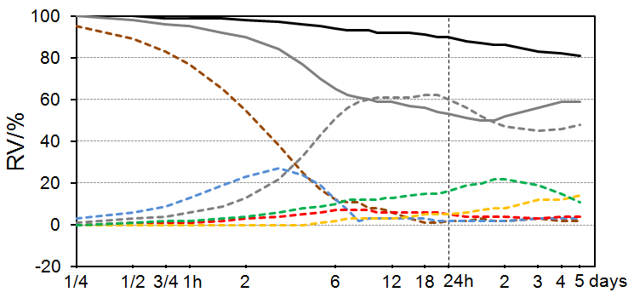
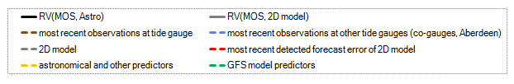
RV(MOS,Astro) and RV(MOS,DMO(2D-Model)) (cont. lines) and Contributions of Predictor Groups to RV(MOS,Astro) (dashed l.)

Slide 6
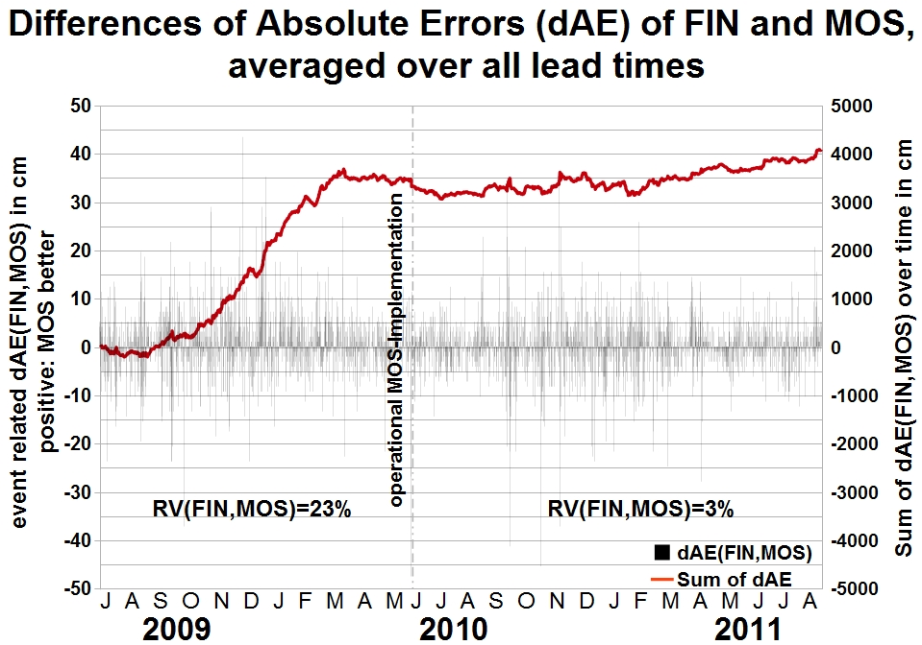
Comparative verification MOS as compared to FIN (=Final Oceanographers Forecast)

Slide 7
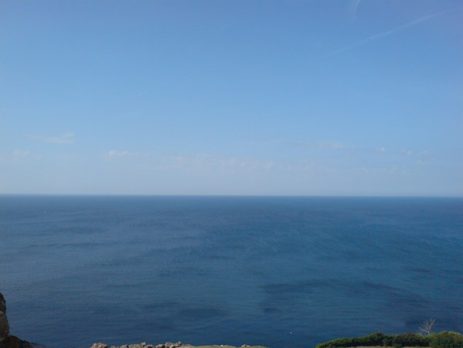
Thank you for your attention.
(more details: Poster 918)
www.bsh.de
www.mswr.de

