Slide 1

20 years of MOS product development at Meteo Service
14.12.2015
METEO SERVICE | 20 years of MOS product development at Meteo Service

Slide 2
Outline
0
History
1
MOS technology
2
MOS applications, forecast examples, verification
3
Interpolation in space
4
Future

Slide 3
0
History
METEO SERVICE | 20 years of MOS product development at Meteo Service

Slide 4
0
History
Meteo Service: History
Pre-History
Jul 1990 Klaus Knüpffer visits Bob Glahn and others at TDL
1991 ECMWF-MOS at Meteo Consult Wageningen (now: MeteoGroup)
1993 Kalman Filtering of EM (Europa-Modell) at DWD
Coefficient (not forecast) interpolation in space.
1993 K. Knüpffer makes a proposal for a European Centre for Statistical Postprocessing
Jan 1994 METEO SERVICE weather research GmbH founded by Klaus Knüpffer and Diederik Haalman
1995 Auto-TAF: MOS-guidance + encoded TAF and GAFOR
1996 Kalman-Filtering of ECMWF Ensembles: RV=10…20%
1998 GME-MOS for standard weather elements for DWD: MOS coefficient interpolation in space (old scheme)
2000 Start of weather forecasting tournaments
2001-05 MOS NowCasting systems: Radar-MOS, Lightning-MOS
Integration into WarnMOS and Auto-TAF
2005 MSwr-GFS-MOS operational
Transition from big projects for big clients to operational provision of MSwr-GFS-MOS for smaller weather forecasting companies.
2009 Water level forecasts: North Sea and rivers.
2010 New MOS coefficient interpolation scheme in space operational:
Complete MOS forecasts (without NIL values).
2014/15 GFS-ECMWF-HIRLAM-MOS-Mix
2014/15 Transition of the new spatial interpolation system to DWD.
http://prognose.met.fu-berlin.de/index_en.php
METEO SERVICE | 20 years of MOS product development at Meteo Service

Slide 5
0
History
Meteo Service: Strength and weaknesses
Strength
Intuitive approach with high success rate
Classical, timeless set-up of the FORTRAN-bash-system with database-like structure,
controlled by configuration files
- No structural changes during the last 20 years and
- fit for the coming 20 years
One solution for all elements
Strictly RMSE optimized (other optimizations possible)
Simple algorithms with high transparency (important for system development and debugging)
Strictly linear regression. All non-linear aspects are dealed with by transformations:
- analytical transformations
- empirical transformations
http://prognose.met.fu-berlin.de/index_en.php
METEO SERVICE | 20 years of MOS product development at Meteo Service

Slide 6
0
History
Meteo Service: Strength and weaknesses
Weakness
We are still (alive but too) small
We cannot afford all good observation and model data
Internal reasons:
- PR insufficient
Why don‘t we have one global MOS manufacture which blends the MOS forecasts of all the good models into one – seamless from NowCast until extended Medium range?
http://prognose.met.fu-berlin.de/index_en.php
METEO SERVICE | 20 years of MOS product development at Meteo Service

Slide 7
1
MOS technology
METEO SERVICE | 20 years of MOS product development at Meteo Service

Slide 8
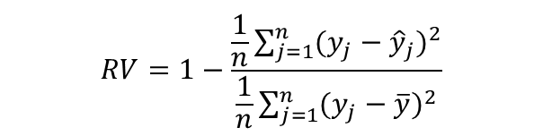
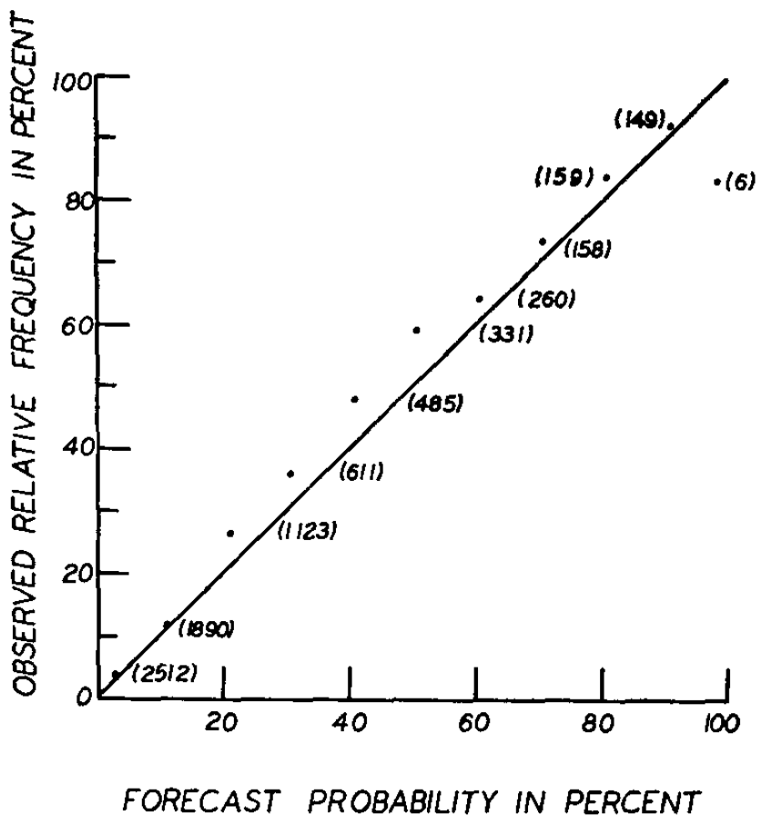
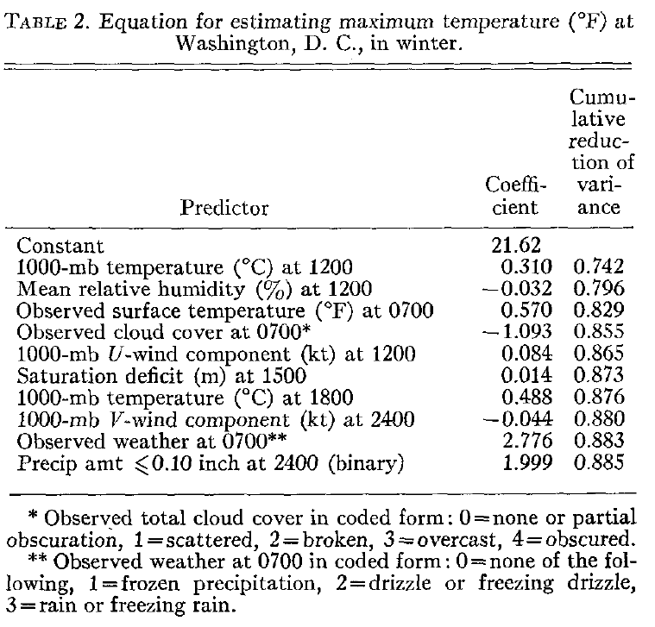
1
MOS technology
„The MOS technology is, in effect, the determination of the weather-related statistics of a numerical model.“
Glahn, H.R., Lowry, D.A.: The use of model output statistics (MOS) in objective weather forecasting, J. Appl. Meteor., 11(1972),1203-1211
regression
procedure
surface wind
maximum temperature
cloud amount
probability of precipitation
conditional probability of frozen precipitation
METEO SERVICE | 20 years of MOS product development at Meteo Service

Slide 9
1
MOS technology
Why MOS?
MOS reduces about 50% of the error variance of the DMO:
RV(MOS,DMO)=50% on the average: for standard weather elements
In other words:
The sum of squared errors of MOS forecasts is only half of the sum of squared errors of the corresponding DMO forecasts
probabilities
elements which are not predicted by the model (e.g. visibility)
METEO SERVICE | 20 years of MOS product development at Meteo Service

Slide 10
2
MOS applications, forecast examples, verification
METEO SERVICE | 20 years of MOS product development at Meteo Service

Slide 11
2
MOS applications, forecast examples, verification
MOS applications
Standard weather element forecasts
Aviation: Auto-TAF
NowCast applications
Radar and lightning MOS, CellMOS, WarnMOS
Wind and solar energy forecast
Water level forecasts
METEO SERVICE | 20 years of MOS product development at Meteo Service

Slide 12
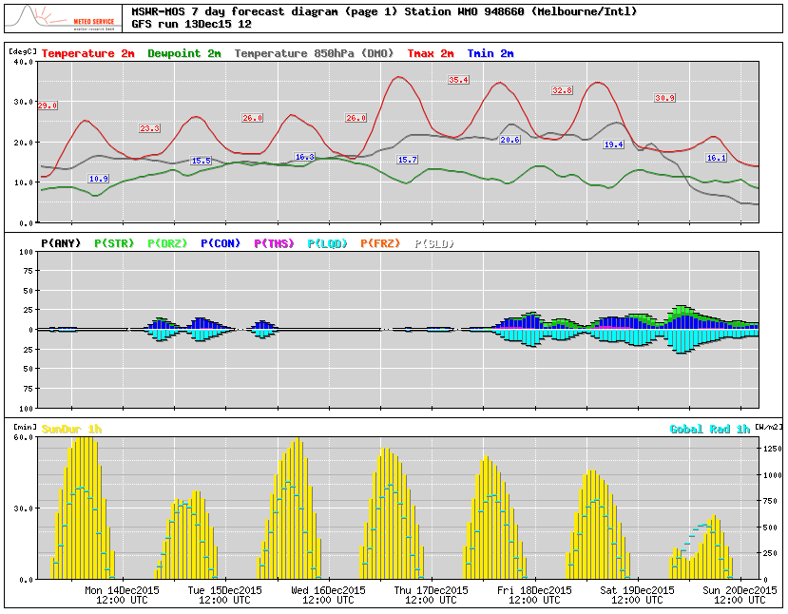
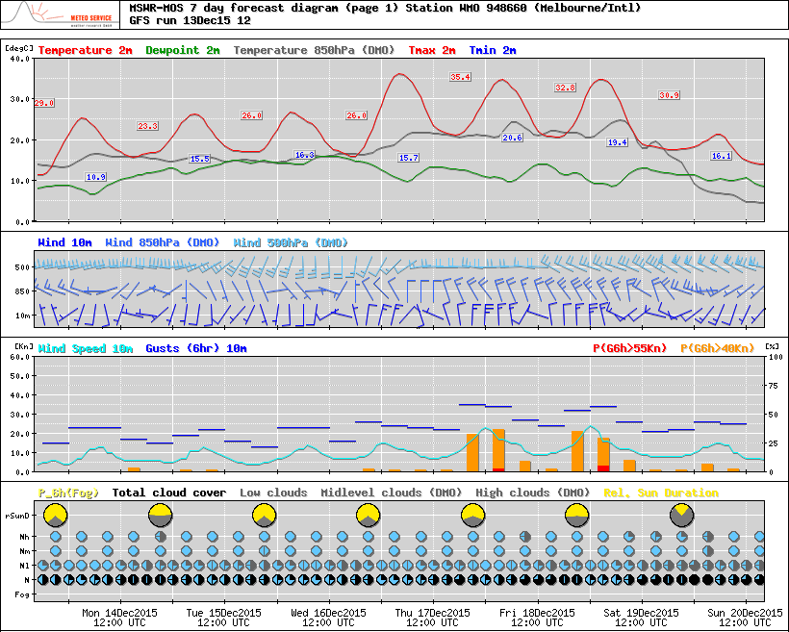
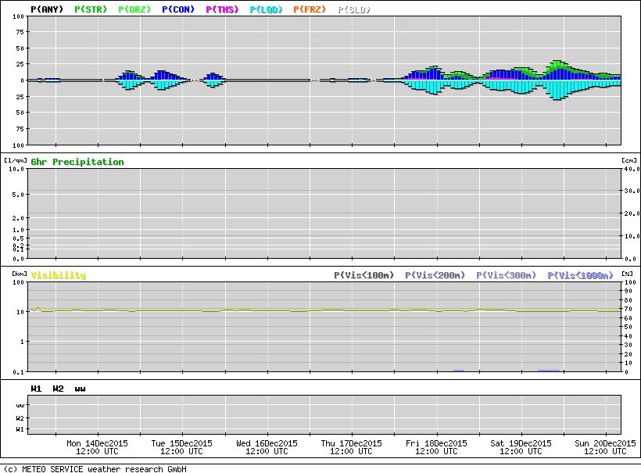
Standard weather element forecasts
MSwr-MOS: WMO 94866 Melbourne/Intl, GFS run 13Dec15 12z, 2015
temperature 2m
dewpoint 2m
temperature 850hPa
hourly probs of precipitation type and phase
hourly sunshine duration
global radiation
METEO SERVICE | 20 years of MOS product development at Meteo Service

Slide 13
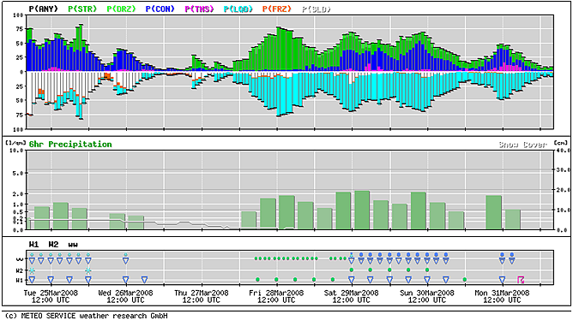
2
MOS applications, forecast examples, verification
MSwr-MOS forecast Hamburg, Germany, GFS run 25Mar08 00z
METEO SERVICE | 20 years of MOS product development at Meteo Service

Slide 14
2
MOS applications, forecast examples, verification
Background of RV – Reduction of error variance
RV - Rules of the thumb for short range, standard weather elements:
Accuracy decreases with increasing lead time by about 1% RV/hour
progress during the last 25 years goes with about 2,5% RV/year.
RV(MOS,DMO)=50% means according to these rules:
50% RV is equivalent to
MOS forecasts three days ahead are about as accurate as DMO forecasts one day ahead
MOS forecasts of the year 1994 had about the same accuracy as DMO forecasts in 2014
Per decade we predict one day further with the same accuracy.
METEO SERVICE | 20 years of MOS product development at Meteo Service

Slide 15
2
MOS applications, forecast examples, verification
MOS reduces 15-30% of the error variance of Kalman Filter
RV [%]
EM: Europa-Modell (DWD)
METEO SERVICE | 20 years of MOS product development at Meteo Service

Slide 16
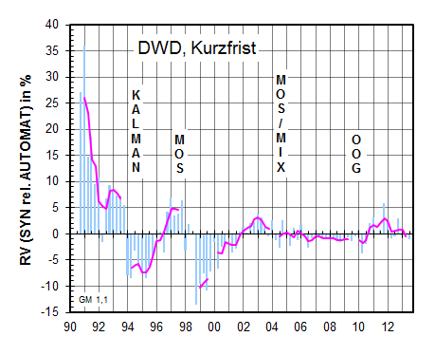
2
MOS applications, forecast examples, verification
human + machine vs. machine
DWD, short range
RV (human + machine rel. machine) [%]
source: DWD short range verification 1998/1999
METEO SERVICE | 20 years of MOS product development at Meteo Service

Slide 17
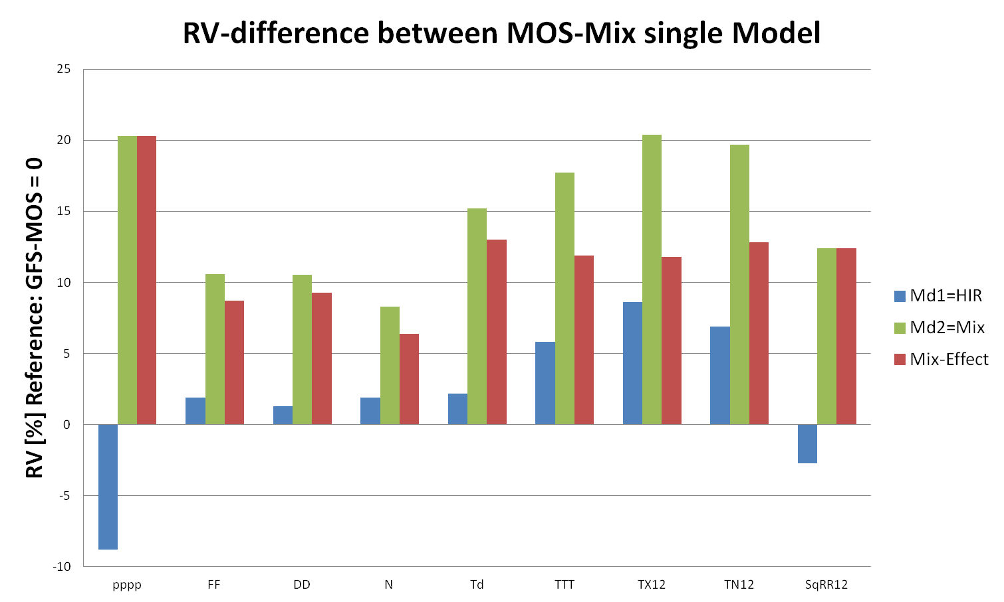
2
MOS applications, forecast examples, verification
Mix-Effect:= RV difference between MOS-Mix and the best single MOS out of GFS-MOS and HIRLAM-MOS
HIR
Mix
Mix-Effect
METEO SERVICE | 20 years of MOS product development at Meteo Service

Slide 18
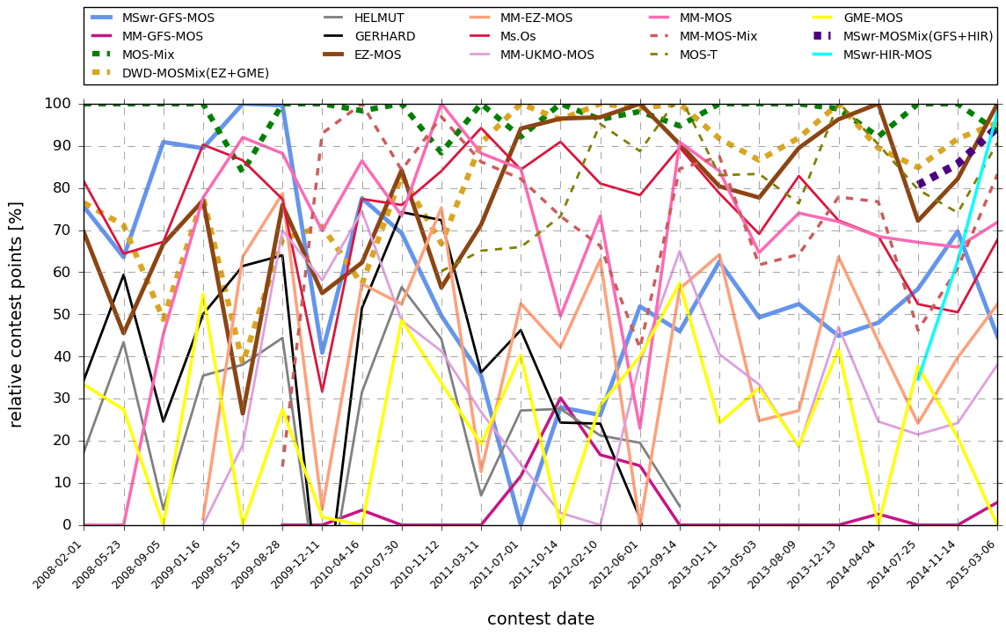
2
MOS applications, forecast examples, verification
German Weather forecasting contest: www.wetterturnier.de 5 cities, MOS forecasts only
MSwr-GFS-MOS
MSwr-HIR-MOS
MSwr-MOSMix(GFS+HIR)
DWD-MOSMix(EZ+GME)
MOS-Mix(EZ+GME+GFS)
relative contest points [%]
contest date
METEO SERVICE | 20 years of MOS product development at Meteo Service

Slide 19
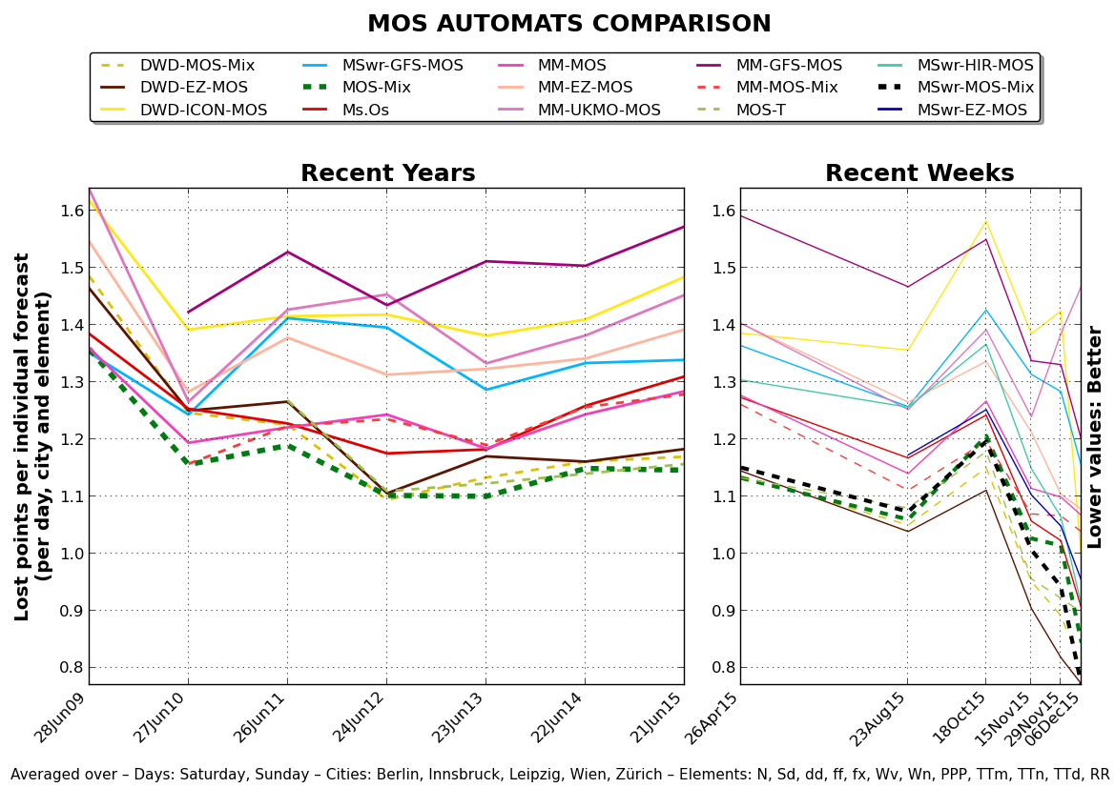
2
MOS applications, forecast examples, verification
German Weather forecasting contest: www.wetterturnier.de 5 cities, MOS forecasts only
DWD-EZ-MOS
Ms.Os
MM-EZ-MOS
MSwr-EZ-MOS
MSwr-GFS-MOS
DWD-MOS-Mix
MOS-Mix
MSwr-HIR-MOS
MSwr-EZ-MOS
MSwr-MOS-Mix
METEO SERVICE | 20 years of MOS product development at Meteo Service

Slide 20

2
MOS applications, forecast examples, verification
- Australian AMOS Weather Tipping Competition
participation with MSwr-GFS-MOS
players are required to submit forecasts for minimum temperature, maximum temperature and rainfall
3 participations in the years 2013, 2014 and 2015
year | MSwr | BOM
2013
2014
2015 | 3. | 14.
comparison of results of
MSwr and BOM:
METEO SERVICE | 20 years of MOS product development at Meteo Service

Slide 21
2
MOS applications, forecast examples, verification
Proposal for a general verification platform:
Many different providers offer their different forecasts to
the public.
User have little control over the accuracy of the
forecasts, e.g. weather apps.
The differences are up to RV=70%, equivalent to several
decades of progress.
It would be good to have a general verification platform for all forecasts provided to the public.
METEO SERVICE | 20 years of MOS product development at Meteo Service

Slide 22
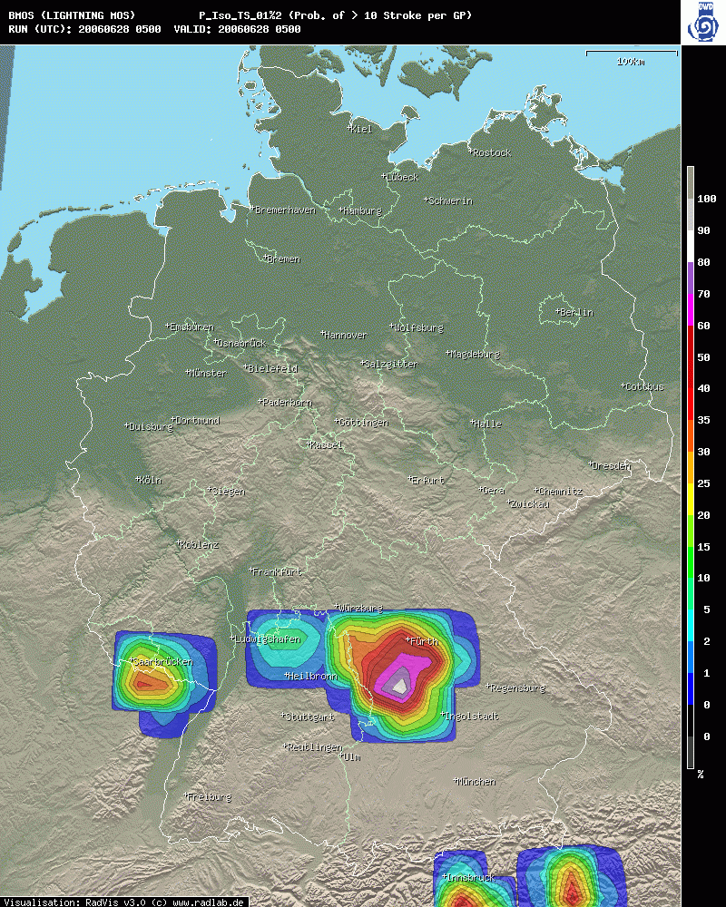
2
MOS applications, forecast examples, verification
BlitzMOS
probability > 10 strokes / 15 min
resolution: 27/27km
Issued:
5z, 28 Jun 2006
3h-forecast
METEO SERVICE | 20 years of MOS product development at Meteo Service

Slide 23
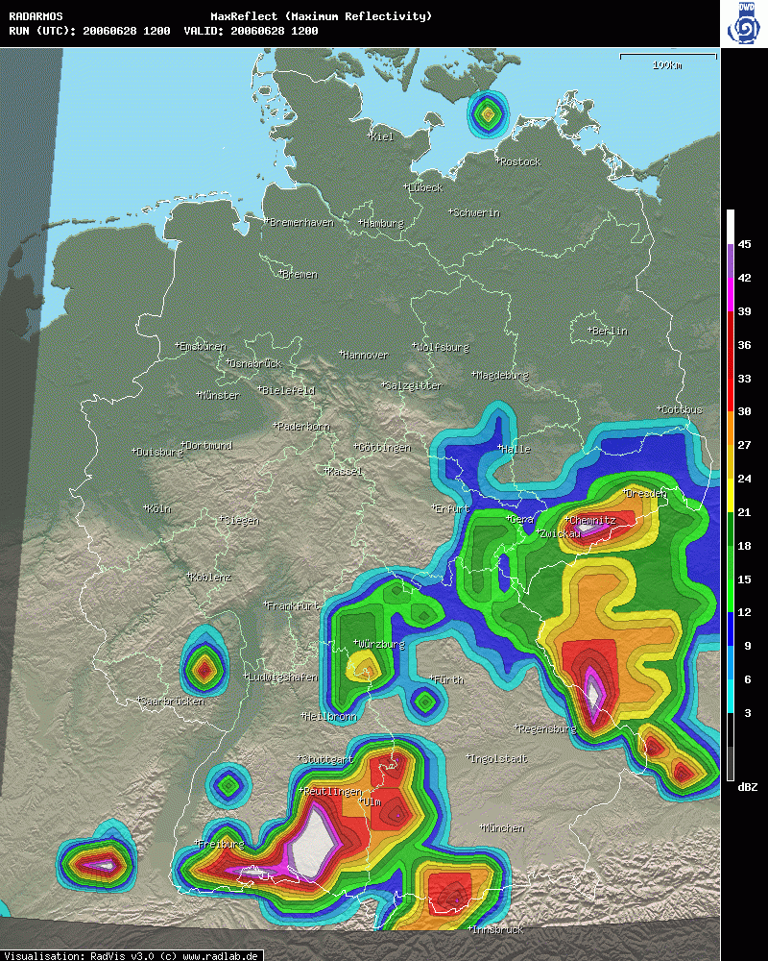
2
MOS applications, forecast examples, verification
RadarMOS
maximum radar reflectivity / 15 min
resolution: 27/27km
Issued:
12z, 28 Jun 2006
3h-forecast
METEO SERVICE | 20 years of MOS product development at Meteo Service

Slide 24
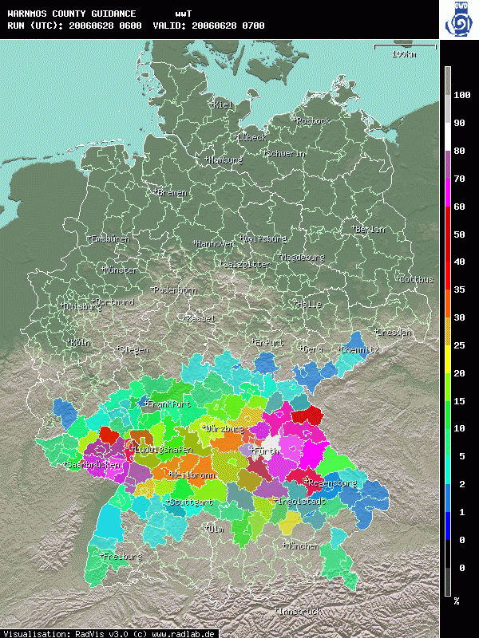
2
MOS applications, forecast examples, verification
WarnMOS
hourly thunderstorm probability
Issued:
06z, 28 Jun 2006
12h-forecast
METEO SERVICE | 20 years of MOS product development at Meteo Service

Slide 25
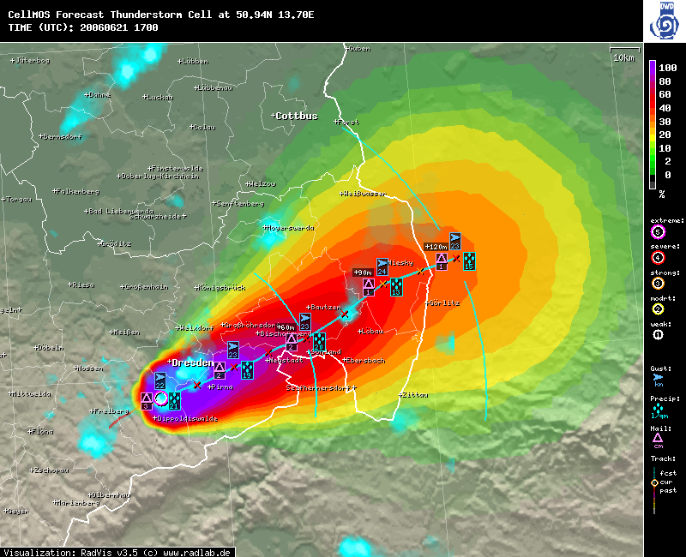
2
MOS applications, forecast examples, verification
Cell-MOS
2-hrs forecast: Thunderstorm cell near Dresden
Issued:
17z, 21 Jun 2006
METEO SERVICE | 20 years of MOS product development at Meteo Service

Slide 26
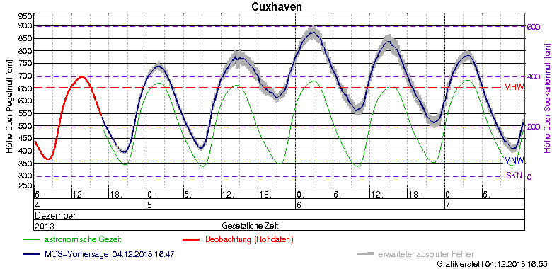
2
MOS applications, forecast examples, verification
forecast example BSHMOS – water level forecast North Sea
storm surge, 06Dez13
height over gauge zero point [cm]
height over chart datum [cm]
December
2013
time
astronomical tide
observation
MOS-forecast, 4 Dec 13, 4:47pm
abs. error (expected)
METEO SERVICE | 20 years of MOS product development at Meteo Service

Slide 27
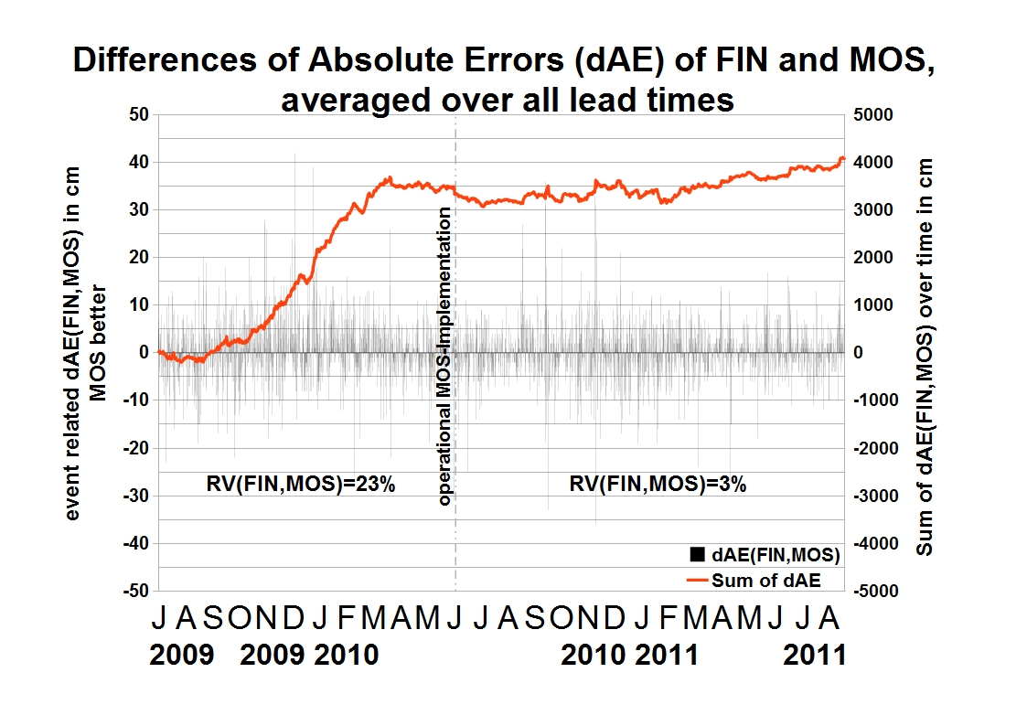
2
MOS applications, forecast examples, verification
Differences of absolute errors (∆AE) of FIN
and MOS, averaged over all lead times
event related ∆AE (FIN,MOS) in cm
positive: MOS better
sum of ∆AE (FIN,MOS) over time in cm
RV(MOS,FIN)=23%
RV(MOS,FIN)=3%
RV(FIN,DMO)=34%
RV(MOS,DMO)=50%
∆AE = ABS_Err(FIN) – ABS_Err(MOS)
METEO SERVICE | 20 years of MOS product development at Meteo Service

Slide 28
2
MOS applications, forecast examples, verification
The effect of higher model resolution on the accuracy of the MOS forecasts
RV (MOS_Res, MOS_1deg)
no changes between 0.5° and 1° !
100 %
?
0 %
?
?
RV climate
0.0625
0.125
0.25
0.5
1
2
4
8
16
Res/deg
METEO SERVICE | 20 years of MOS product development at Meteo Service

Slide 29
3
Interpolation in space
METEO SERVICE | 20 years of MOS product development at Meteo Service

Slide 30
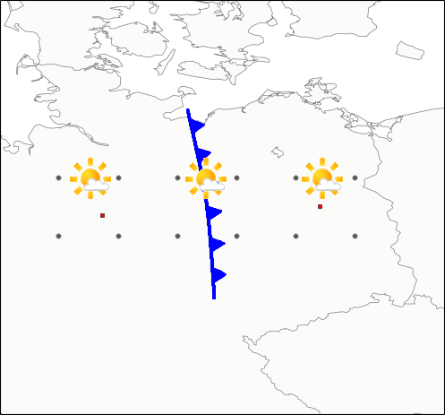
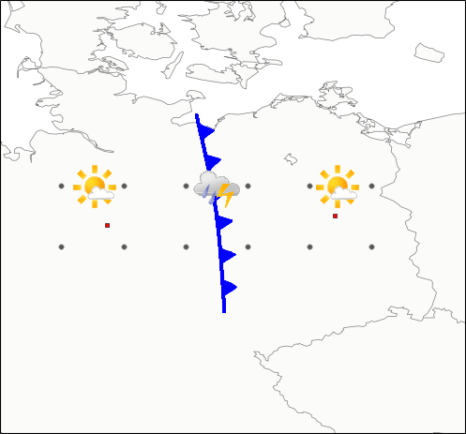
3
Interpolation in space
Motivation for coefficient (not forecast) interpolation
Interpolation of MOS forecasts
Interpolation of MOS coefficients
24.3°C (?)
12.5°C (!)
19.6°C
29.0°C
19.6°C
29.0°C
(?)
(!)
Hannover
Berlin
Hannover
Berlin
Forecast Example
Forecast Example
METEO SERVICE | 20 years of MOS product development at Meteo Service

Slide 31
3
Interpolation in space
Motivation for coefficient (not forecast) interpolation
Berlin : MOS = 1,0*DMO_T2m - 0,2*DMO_FF10m/kn Hannover : MOS = 2 + 1,0*DMO_T2m - 4*rH_1000_hPa --------------------------------------------------------------------- Magdeburg: MOS = 1 + 1,0*DMO_T2m - 2*rH_1000_hPa - 0,1*DMO_FF10m/kn
Magdeburg coefficients is 50:50 mix from Berlin and Hannover coefficients
DMO_T2m rH_1000_hPa DMO_FF10m/kn --> Interpolated Fc ------------------------------------------------------------------- Berlin 30 irrelevant 5 29,0 deg C Magdeburg 15 1,0 15 12,5 deg C
24,3 deg C (*) Hannover 20 0,6 irrelevant 19,6 deg C ------------------------------------------------------------------- (*): Forecast interpolation
METEO SERVICE | 20 years of MOS product development at Meteo Service

Slide 32
3
Interpolation in space
How to Extend the Benefit of MOS to the Area?
Meteo Service has introduced a technology which relies on the
Interpolation of MOS coefficients - not of forecasts
Orographic descriptors are used based on high resolution orography information. Orography information with a resolution of 1x1 km is used for the definition of the following orographic descriptors - with different spatial smoothing:
Elevation
slope: = first derivative of elevation
(u and v component)
METEO SERVICE | 20 years of MOS product development at Meteo Service

Slide 33
3
Interpolation in space
How to Extend the Benefit of MOS to the Area?
MOS coefficient interpolation
Decision Tree
You can't be worse than forecast interpolation, only better
MOS-Interpolation
You miss the model information between the observing stations
MOS Forecast interpolation
MOS equations based on Objective Analysis
Objective Analysis
You play the wrong game but you play it and show MOS performs better than adaptive schemes
nobody knows how good it is
You don't catch the error characteristics of the OA which may be as dominating as detoriating
MOS equations based on Observations
Good Way
Wrong Way
METEO SERVICE | 20 years of MOS product development at Meteo Service

Slide 34
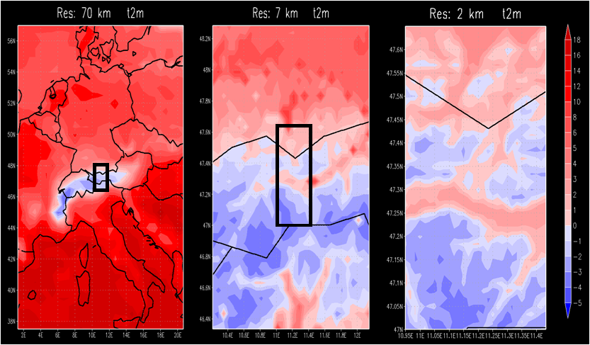
3
Interpolation in space
METEO SERVICE | 20 years of MOS product development at Meteo Service

Slide 35
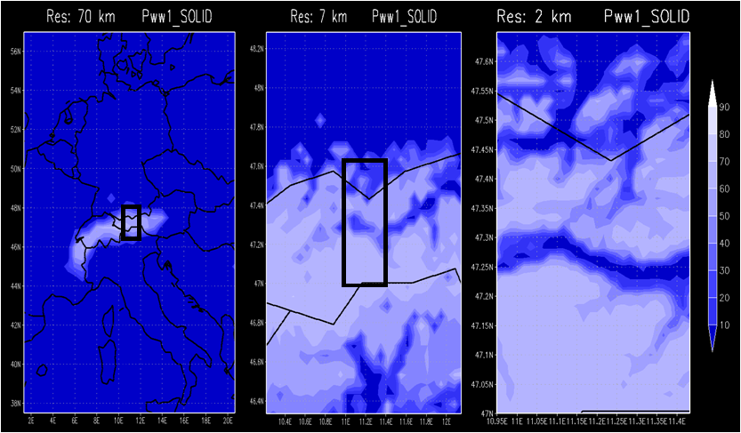
3
Interpolation in space
METEO SERVICE | 20 years of MOS product development at Meteo Service

Slide 36
3
Interpolation in space
“As you know, I prefer using observations as predictands, even though they are available at a limited number of points. When the analysis of observations is developed to the point that auxiliary data (such as satellite and radar) are used and it can be shown by rigorous tests that the areas between the observations of the elements being analyzed are close to what an observation would have produced, then such analyses could be used as predictand data. However, until auxiliary data are used effectively, I can see no advantage to analyzing the obs and using the analysis as predictand data. It just shifts the burden of analysis to a different place in the process. I am afraid, that because of the NCEP NWP interests, which favor using analyses as predictand data, MOS will become an attempt to produce forecasts of imperfect analyses. One should remember that not only grids are important, but values at specific locations.”
(Bob Glahn, E-Mail 18Oct14)
METEO SERVICE | 20 years of MOS product development at Meteo Service

Slide 37
4
Future
METEO SERVICE | 20 years of MOS product development at Meteo Service

Slide 38
4
Future
The models are continuously improving - and so is MOS technology.
RV(MOS,DMO) = 50% is confirmed as an almost 'universal constant'.
METEO SERVICE | 20 years of MOS product development at Meteo Service

Slide 39
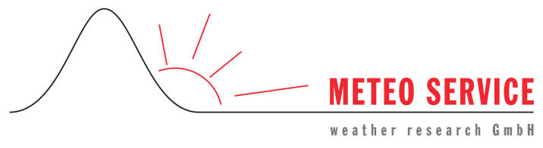

Thank you for your attention
We welcome your questions, suggestions, comments!
klaus@mswr.de
www.mswr.de
METEO SERVICE | 20 years of MOS product development at Meteo Service

