Slide 1
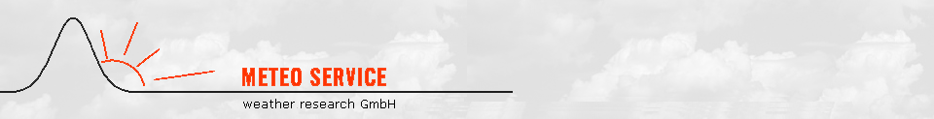

Interpolation of MOS forecasts
- based on MOS coefficient (not forecast) interpolation -
Klaus Knüpffer
NOAA, MDL
Phoenix, 05.01.2015

Slide 2
Outline
1
Motivation
2
How to bring the benefit of MOS to the area? - MOS coefficient interpolation
3
Explanations
3.1
2-dimensional (North German Plane)
3.2
3-dimensional (Alpine Seefeld area)
4
n-dimensional Examples
4.1
Representative stations for Toggenburg (NY, US)
4.2
Forecasting examples for 30.000 cities in Switzerland
4.3
Forecasting examples for Alpine Seefeld region
5
Verification
6
Summary and Outlook

Slide 3
History of Meteo Service
Pre-History
Jul 1990 Klaus Knüpffer visits Bob Glahn and others at TDL
1991 ECMWF-MOS at Meteo Consult Wageningen (now: MeteoGroup)
1993 Kalman Filtering of EM (Europa-Modell) at DWD
Coefficient (not forecast) interpolation in space.
1993 K. Knüpffer makes a proposal for a European Centre for Statistical Postprocessing
Jan 1994 METEO SERVICE weather research GmbH founded by Klaus Knüpffer and Diederik Haalman
1995 Auto-TAF: MOS-guidance + encoded TAF and GAFOR
1996 Kalman-Filtering of ECMWF Ensembles: RV=10…20%
1998 GME-MOS for standard weather elements for DWD: MOS coefficient interpolation in
space (old scheme)
2000 Start of weather forecasting tournaments
2001-05 MOS NowCasting systems: Radar-MOS, Lightning-MOS
Integration into WarnMOS and Auto-TAF
2005 MSwr-GFS-MOS operational
1 | Motivation

Slide 4
History of Meteo Service
Transition from big projects for big clients to operational provision of MSwr-GFS-MOS for smaller weather forecasting companies.
2009 Water level forecasts: North Sea and rivers.
2010 New MOS coefficient interpolation scheme in space operational:
Complete MOS forecasts (without NIL values)
Gridded Auto-TAF
2014 GFS-HIRLAM-MOS-Mix
2014/15 Transition of the new spatial interpolation system to DWD for weather warning MOS for DWD.
2015 GFS-ECMWF-HIRLAM-MOS-Mix
1 | Motivation

Slide 5
Meteo Service: Strength and weaknesses
Strength
Intuitive approach with high success rate
Classical, timeless set-up of the FORTRAN-bash-system with database-like structure,
controlled by configuration files
- No structural changes during the last 20 years and
- fit for the coming 20 years
One solution, globally, for all elements
Strictly RMSE optimized (other optimizations possible)
Simple algorithms with high transparency (important for system development and debugging)
Strictly linear regression. All non-linear aspects are dealed with by transformations:
- analytical transformations
- empirical transformations
1 | Motivation

Slide 6
Meteo Service: Strength and weaknesses
Weaknesses
We are still (alive but too) small
We cannot afford all good observation and model data
Internal reasons:
- PR insufficient
Why don‘t we have one global MOS manufacture which blends the MOS forecasts of all the good models into one – seamless from NowCast until extended Medium range?
1 | Motivation

Slide 7
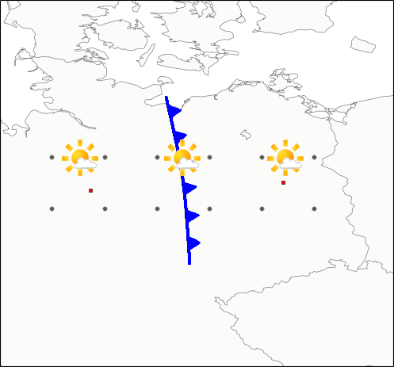
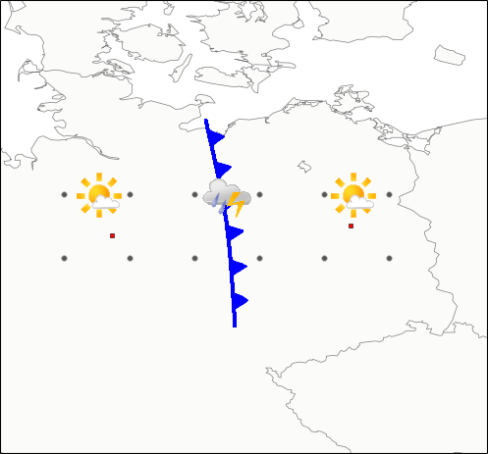
1.) Motivation for coefficient (not forecast) interpolation
Interpolation of MOS forecasts
Interpolation of MOS coefficients
24.3°C (?)
12.5°C (!)
19.6°C
29.0°C
19.6°C
29.0°C
(?)
(!)
Hannover
Berlin
Hannover
Berlin
Forecast Example
Forecast Example
1 | Motivation

Slide 8
1.) Motivation for coefficient (not forecast) interpolation
Berlin : MOS = 1,0*DMO_T2m - 0,2*DMO_FF10m/kn Hannover : MOS = 2 + 1,0*DMO_T2m - 4*rH_1000_hPa --------------------------------------------------------------------- Magdeburg: MOS = 1 + 1,0*DMO_T2m - 2*rH_1000_hPa - 0,1*DMO_FF10m/kn
Magdeburg coefficients is 50:50 mix from Berlin and Hannover coefficients
DMO_T2m rH_1000_hPa DMO_FF10m/kn --> Interpolated Fc ------------------------------------------------------------------- Berlin 30 irrelevant 5 29,0 deg C Magdeburg 15 1,0 15 12,5 deg C
24,3 deg C (*) Hannover 20 0,6 irrelevant 19,6 deg C ------------------------------------------------------------------- (*): Forecast interpolation
1 | Motivation

Slide 9
MOS reduces 15-30% of the error variance of Kalman Filter
EM: Europa-Modell (DWD)
1 | Motivation

Slide 10
2. How to bring the benefit of MOS to the area?
The benefit of MOS as compared to DMO and adaptive Bias correction (Kal) is according to MSwr state of knowledge:
RV(MOS,DMO) = 50% RV(MOS,Kal) = 25%
At NCEP we were told that there is a negative RV(MOS,Kal).
The solution of this contradiction is: Kal is optimized with RTMA (=OA: Objective Analysis) as 'Truth'. MOS is optimized with Station Observations as 'Truth'.
This leads to misleading conclusions and wrong strategies.
2 | How to extend the benefit of MOS to the Area?

Slide 11
There are different experiences at MDL and MSwr regarding RV(MOS,Kal) = 25%.
Bob Glahn, 2014: 'Determining an Optimal Decay Factor for Bias-Correcting MOS Temperature and Dewpoint Forecasts':
'Today, NWP does produce these weather elements directly, and their accuracy makes them prime predictors in the MOS equations. Even so, NWP forecasts can be improved by postprocessing, and in particular the NWP forecasts have biases...‘
MDL : Increasing efforts in bias correction of DMO - Comment MSwr: missing 25% RV(MOS,Kal).
MSwr: Statistical Interpretation of predicted synoptical patterns. Don't want to miss any of the 25% RV(MOS,Kal).
2 | How to extend the benefit of MOS to the Area?

Slide 12
MDL strategy for spatial interpolation
appears to be driven by nwp community:
They produce area means → MDL accepts and also goes on area means
But: People are usually at 'points' (e.g. Grand Canyon)
MSwr strategy for spatial interpolation
individual 'regional equations' for each point. Spatial resolution depends on the
spatial resolution of the orography used (for 5 years: 0,5'x0,5'-orography).
Basics:
People are at points
Point observations as basis → point forecasts (consistently)
No unreasonable spatial inhomogenities between forecasts for observing stations
and for their environment
MOS-Interpolation is something like 'OA based on station observations, model forecasts and
orography only‘
Forecast-Interpolation would be something like 'OA based on station observations and orography only'
2 | How to extend the benefit of MOS to the Area?

Slide 13
Decision Tree
MOS coefficient interpolation
You can't be worse than forecast interpolation, only better
MOS-Interpolation
You miss the model information between the observing stations
MOS Forecast interpolation
MOS equations based on Objective Analysis
Objective Analysis
You play the wrong game but you play it and show MOS performs better than adaptive schemes
nobody knows how good it is
You don't catch the error characteristics of OA which may be as dominating as detoriating
Good Way
Wrong Way
MOS equations based on Observations
2 | How to extend the benefit of MOS to the Area?

Slide 14
The wrong strategy is: Kalman-Filtering instead of MOS. (Kalman Filtering of MOS forecasts may be OK).
2 | How to extend the benefit of MOS to the Area?

Slide 15
2. How to extend the benefit of MOS to the Area?
MOS forecasts are usually only provided at the very places where the observation locations are situated.
A technology is outlined which allows MOS forecasts
for any location between the observation locations.
2 | How to extend the benefit of MOS to the Area?

Slide 16
Background of RV – Reduction of error variance
RV - Rules of the thumb for short range, standard weather elements:
Accuracy decreases with increasing lead time by about 1% RV/hour
progress during the last 25 years goes with about 2,5% RV/year.
RV(MOS,DMO)=50% means according to these rules:
50% RV is equivalent to
MOS forecasts three days ahead are about as accurate as DMO forecasts one day ahead
MOS forecasts of the year 1994 had about the same accuracy as DMO forecasts in 2014
Per decade we predict one day further with the same accuracy.
2 | How to extend the benefit of MOS to the Area?

Slide 17
Meteo Service has introduced a technology which relies on the Interpolation of MOS coefficients - not MOS forecasts.
This technology is based on orographic descriptors and has already been in use with the German National Weather Service (DWD) since 1993.
These orographic descriptors refer to latitude, longitude, elevation and the difference between the elevation of the smoothed model orography, and the real elevation.
2 | How to extend the benefit of MOS to the Area?

Slide 18
Since 2009 high resolution orography information is available,
and more orographic descriptors can be used. NOAA/NGDC orographic data is available in a resolution of approximately 1 x 1 km and allows for the definition of the following
27 orographic descriptors with different spatial smoothing:
Elevation
slope: = first derivative of elevation.
Land/Water
2 | How to extend the benefit of MOS to the Area?

Slide 19
Differences between the weighted orography descriptors are used to define the representativeness between interpolation points and observation locations.
This representativeness is the norm of a multi-dimensional vector with the number of dimensions being equal to the number of orography descriptors.
A procedure to search for the most informative set of representative oberservation stations for a given interpolation point is applied and shown below.
Interpolation weights are calculated for the selected oberservation locations based on the representativeness.
2 | How to extend the benefit of MOS to the Area?

Slide 20
Calculation of weights for the stations used for interpolation:
1.) A representative value "Rep(IS,OS) " is calculated:
! range 0 100 and almost linear in nearby range
with grdOro = effective Distance of the station to the interpolation location (respecting geographical distance as well as difference of all orography descriptors)
2.) The weight is calculated based on "Rep(IS,OS) ":
IS: Interpolation Station, OS: Observing Station
2 | How to extend the benefit of MOS to the Area?

Slide 21
Simple example with usage of only two orography descriptors:
- Latitude
- Longitude
Abbreviations:
IS : Interpolation Station
OS: Observing Station
C : Center point of weighted Observing Stations
IC : Interpolation Centre (for searching next observing station)
3 | Explanations

Slide 22
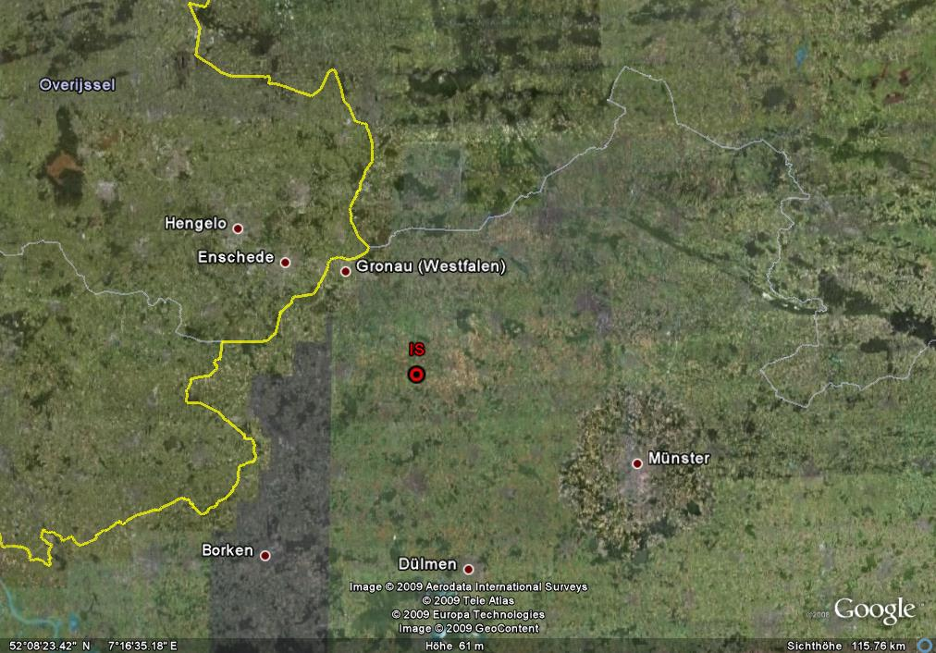
3.1 | Explanations: 2-dimensional (North German Plane)

Slide 23
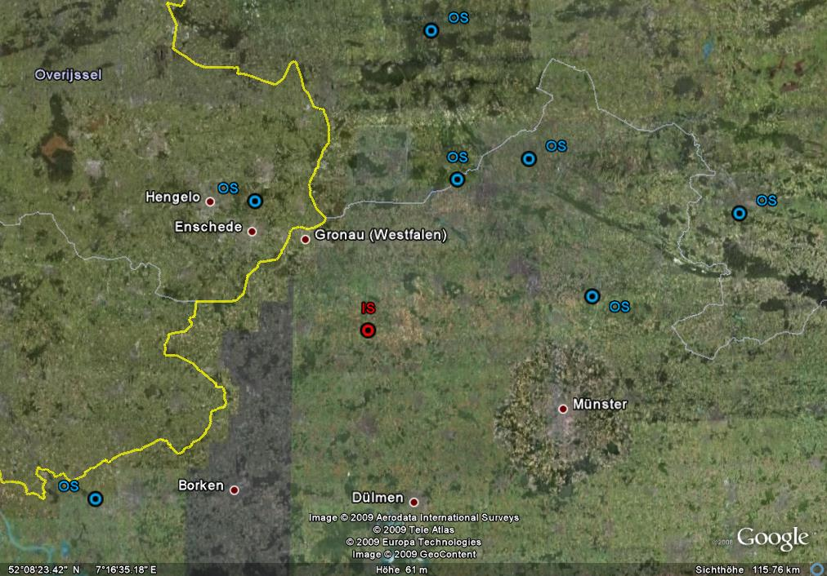
3.1 | Explanations: 2-dimensional (North German Plane)

Slide 24
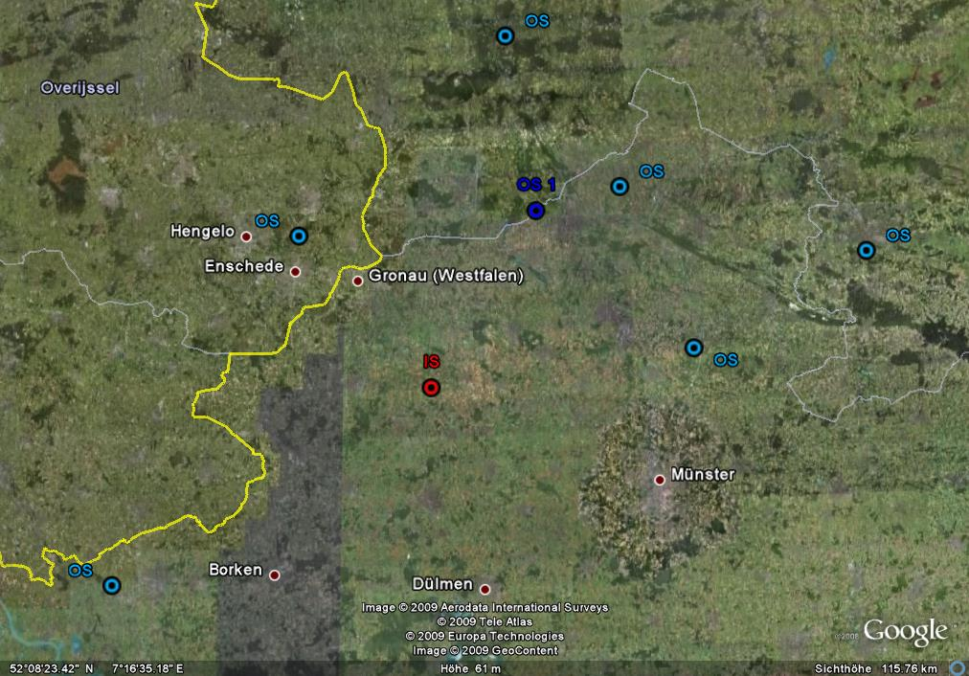
weight
OS 1: 100%
3.1 | Explanations: 2-dimensional (North German Plane)

Slide 25
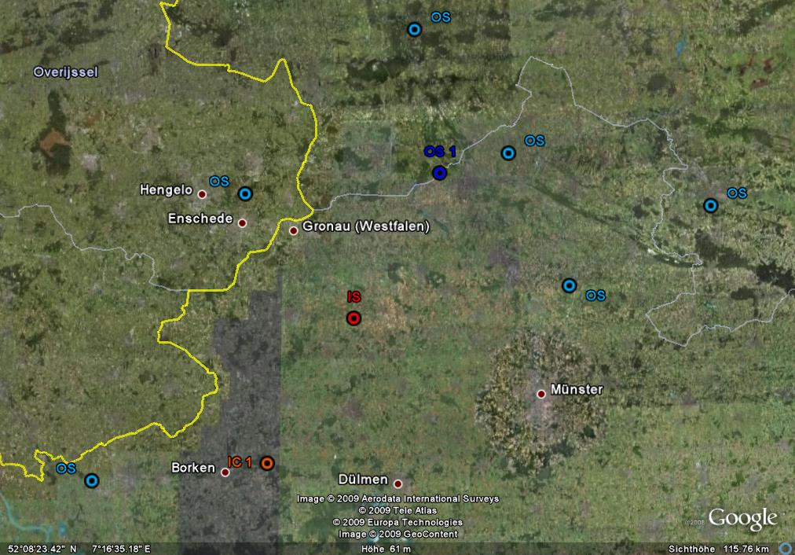
weight
OS 1: 100%
3.1 | Explanations: 2-dimensional (North German Plane)

Slide 26
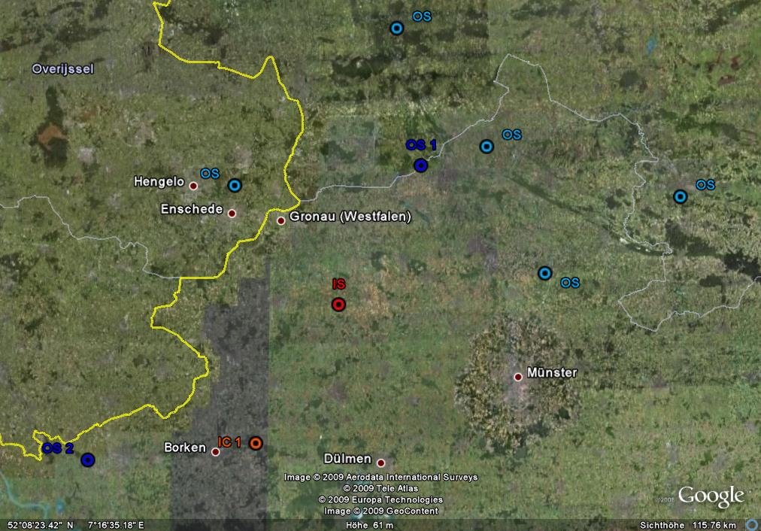
weight
OS 1: 65%
OS 2: 35%
3.1 | Explanations: 2-dimensional (North German Plane)

Slide 27
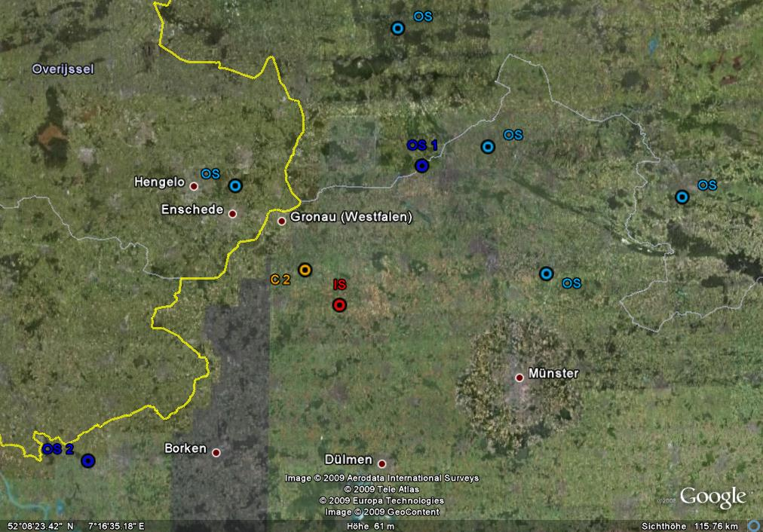
weight
OS 1: 65%
OS 2: 35%
3.1 | Explanations: 2-dimensional (North German Plane)

Slide 28
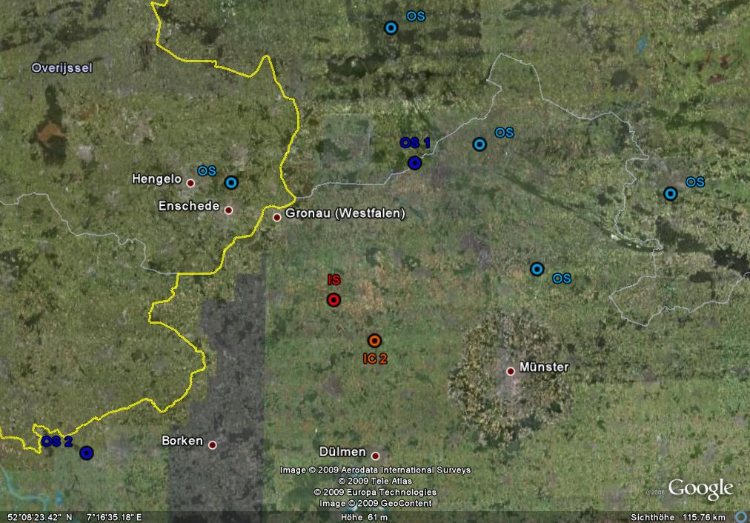
3.1 | Explanations: 2-dimensional (North German Plane)

Slide 29
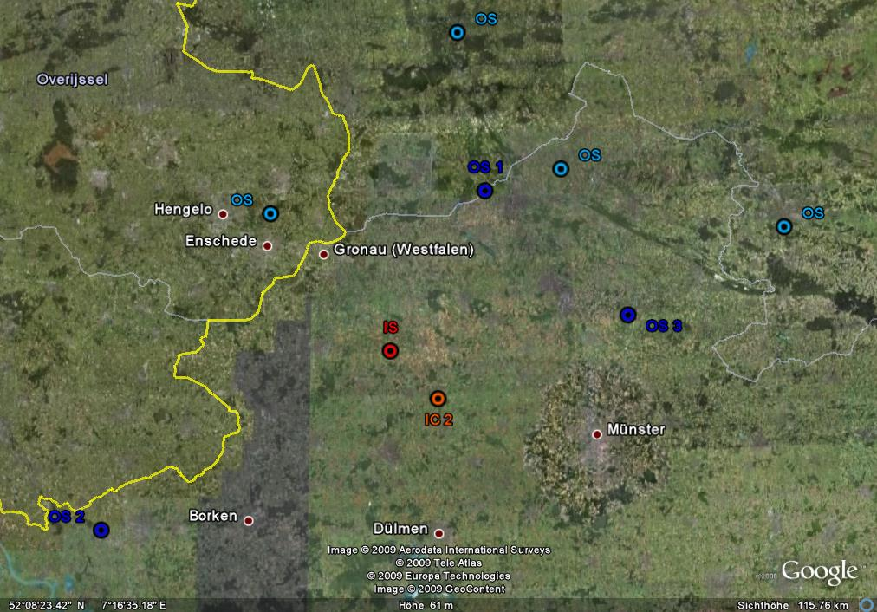
weight
OS 1: 41%
OS 2: 22%
OS 3: 37 %
3.1 | Explanations: 2-dimensional (North German Plane)

Slide 30
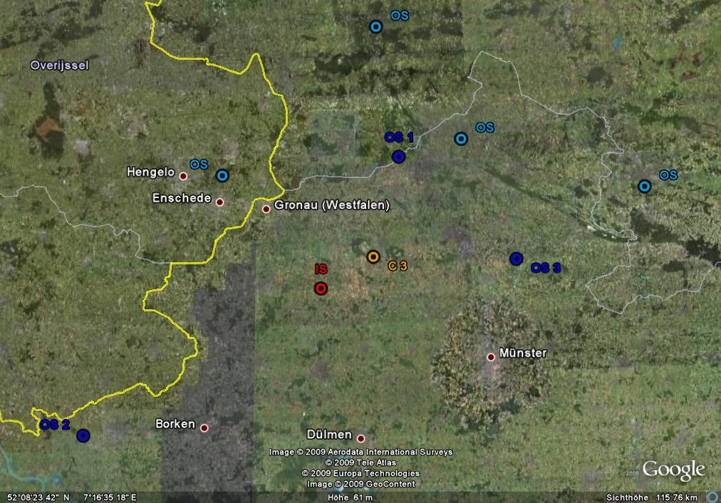
weight
OS 1: 41%
OS 2: 22%
OS 3: 37 %
3.1 | Explanations: 2-dimensional (North German Plane)

Slide 31
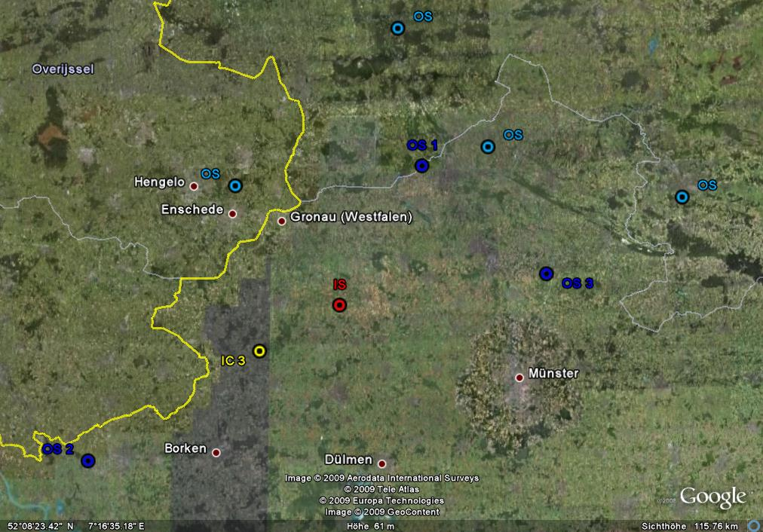
3.1 | Explanations: 2-dimensional (North German Plane)

Slide 32

3.1 | Explanations: 2-dimensional (North German Plane)

Slide 33
3b) Explanations : 3-dimensional (Alpine Seefeld area)
- Latitide
- Longitude
Elevation
Interpolation Point: Seefeld (between Innsbruck and Zugspitze)
Elevation: 1.180 m
3.2 | Explanations: 3-dimensional (Alpine Seefeld area)

Slide 34
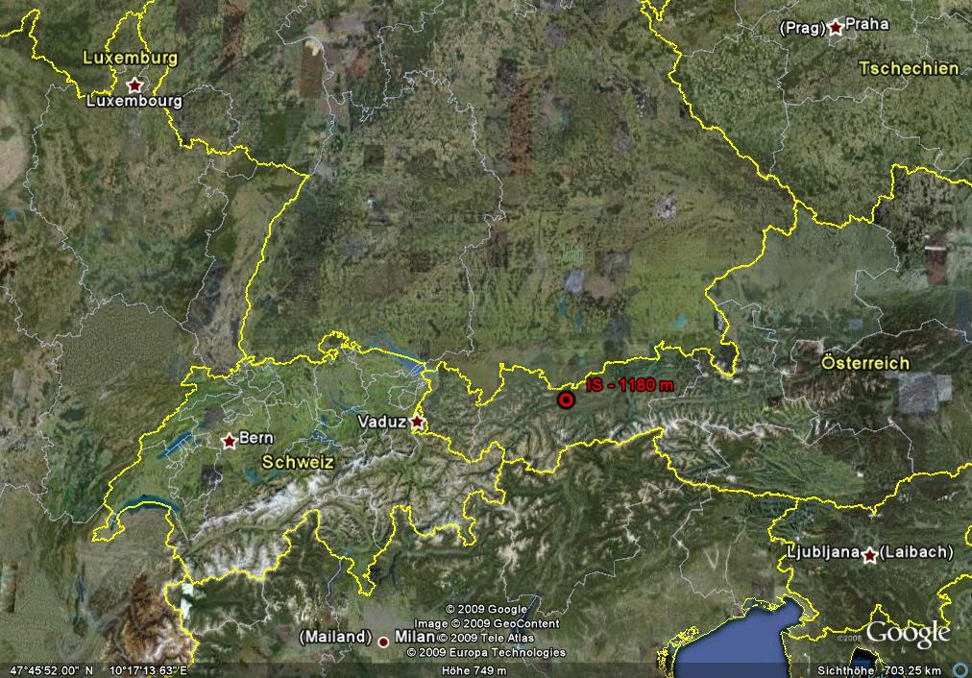
3.2 | Explanations: 3-dimensional (Alpine Seefeld area)

Slide 35
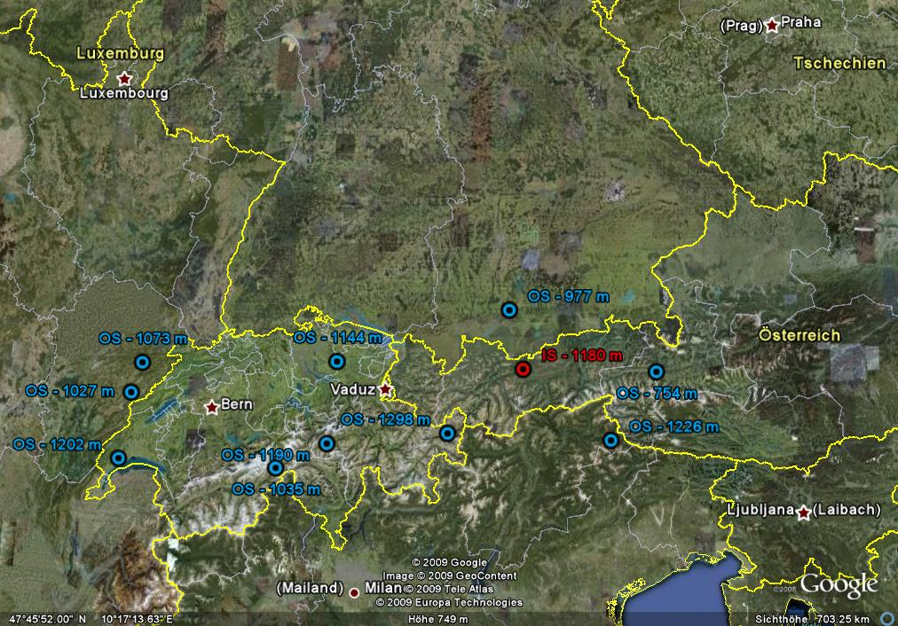
3.2 | Explanations: 3-dimensional (Alpine Seefeld area)

Slide 36
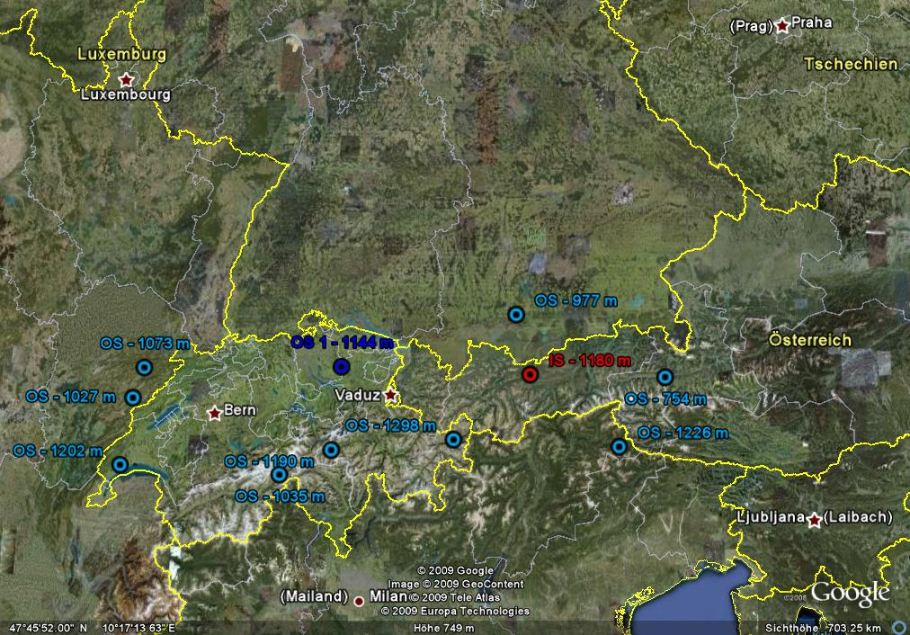
weight
OS 1: 100%
3.2 | Explanations: 3-dimensional (Alpine Seefeld area)

Slide 37
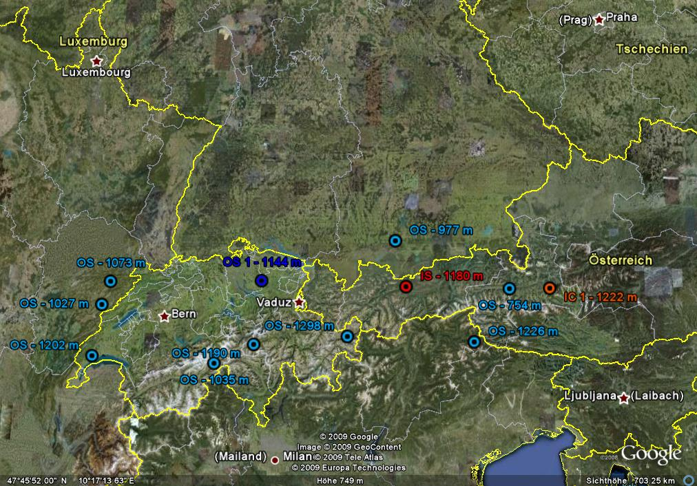
weight
OS 1: 100%
3.2 | Explanations: 3-dimensional (Alpine Seefeld area)

Slide 38
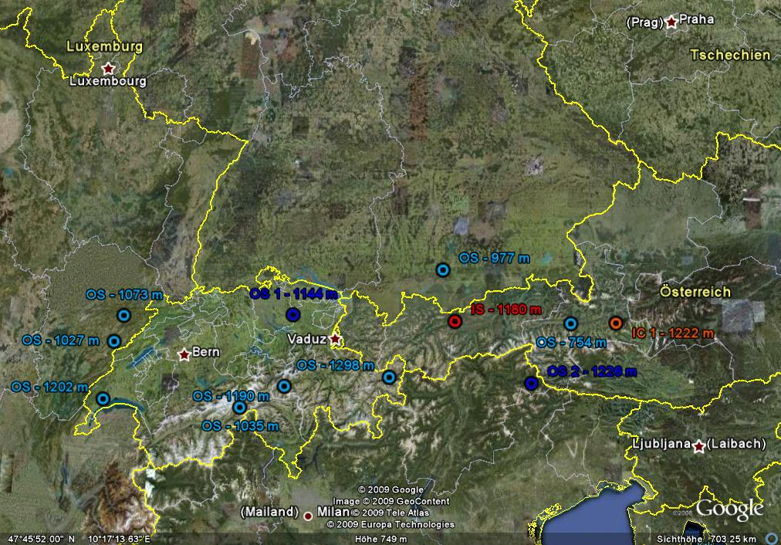
weight
OS 1: 63%
OS 2: 37%
3.2 | Explanations: 3-dimensional (Alpine Seefeld area)

Slide 39
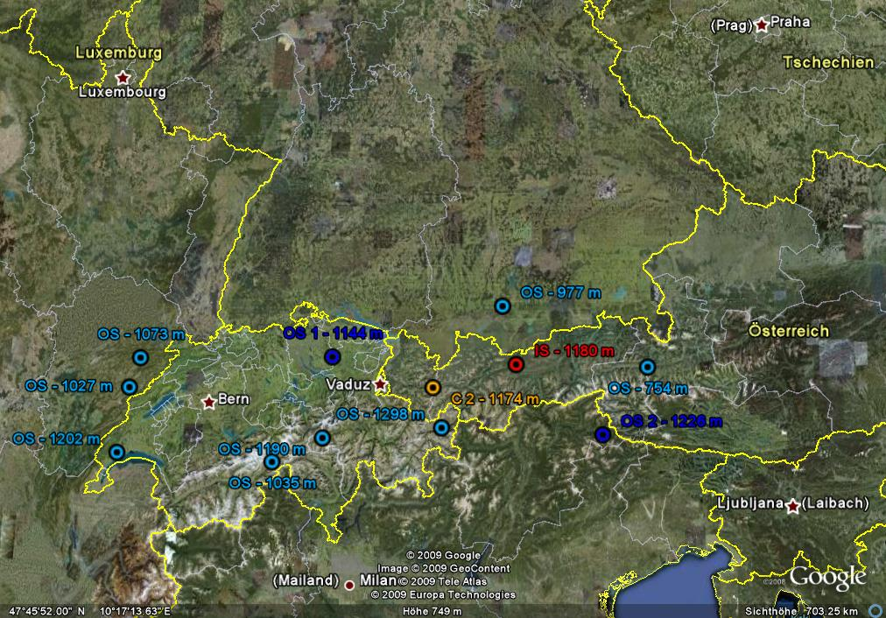
weight
OS 1: 63%
OS 2: 37%
3.2 | Explanations: 3-dimensional (Alpine Seefeld area)

Slide 40

3.2 | Explanations: 3-dimensional (Alpine Seefeld area)

Slide 41

weight
OS 1: 49%
OS 2: 29%
OS 3: 22%
3.2 | Explanations: 3-dimensional (Alpine Seefeld area)

Slide 42
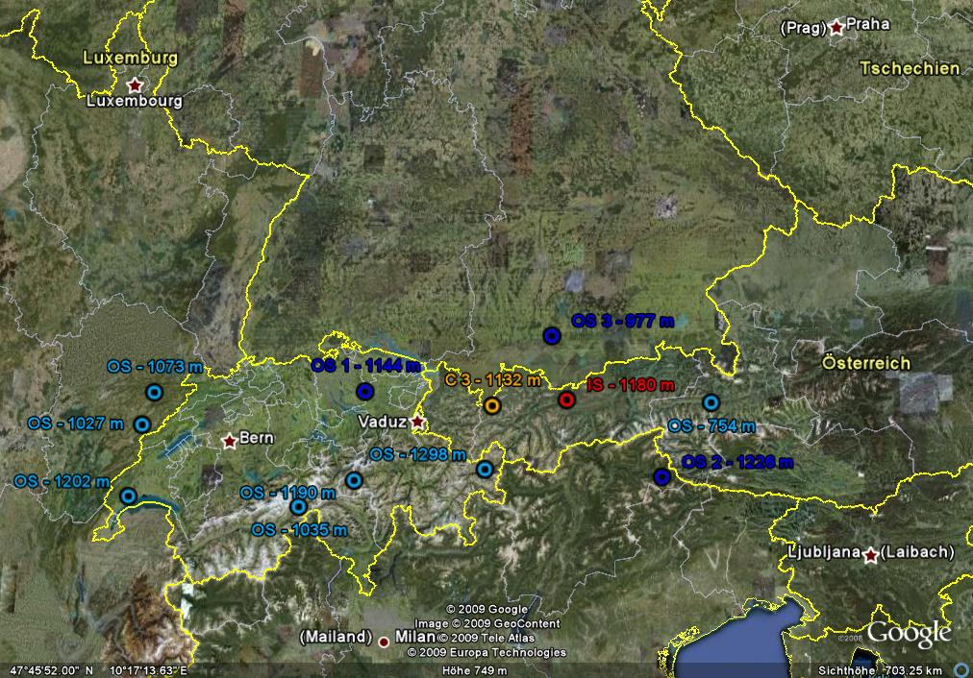
weight
OS 1: 49%
OS 2: 29%
OS 3: 22%
3.2 | Explanations: 3-dimensional (Alpine Seefeld area)

Slide 43

3.2 | Explanations: 3-dimensional (Alpine Seefeld area)

Slide 44

weight
OS 1: 39%
OS 2: 24%
OS 3: 17%
OS 4: 20%
3.2 | Explanations: 3-dimensional (Alpine Seefeld area)

Slide 45

weight
OS 1: 39%
OS 2: 24%
OS 3: 17%
OS 4: 20%
3.2 | Explanations: 3-dimensional (Alpine Seefeld area)

Slide 46

3.2 | Explanations: 3-dimensional (Alpine Seefeld area)

Slide 47
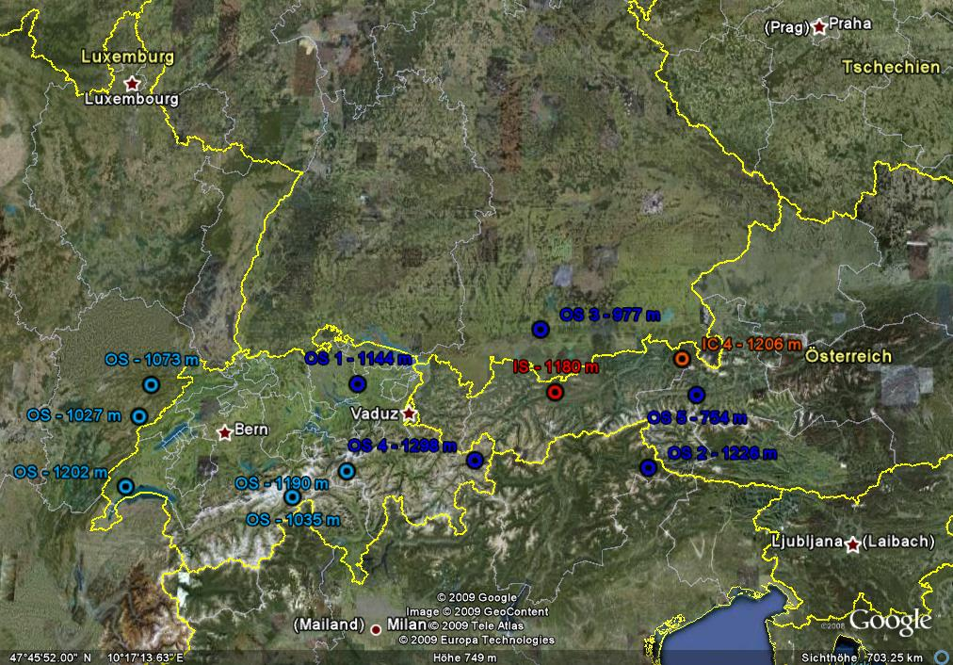
weight
OS 1: 35%
OS 2: 21%
OS 3: 16%
OS 4: 18%
OS 5: 10%
3.2 | Explanations: 3-dimensional (Alpine Seefeld area)

Slide 48
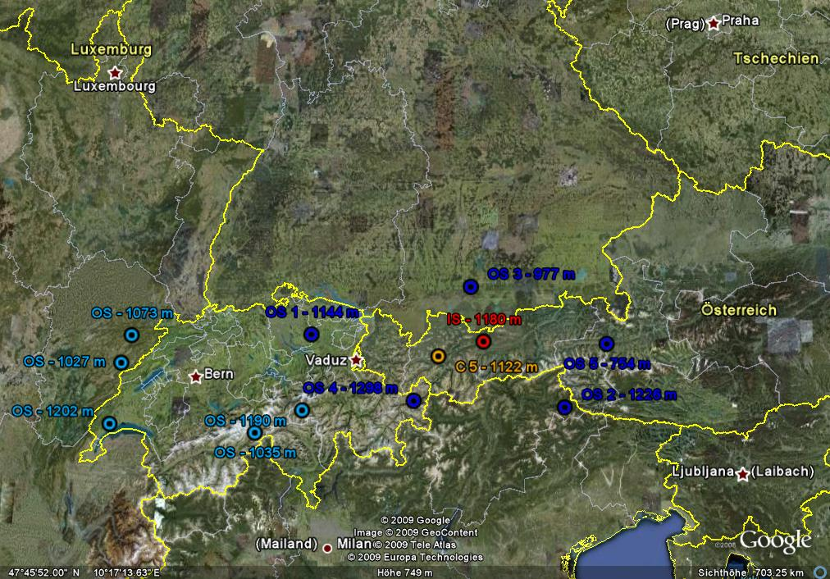
weight
OS 1: 35%
OS 2: 21%
OS 3: 16%
OS 4: 18%
OS 5: 10%
3.2 | Explanations: 3-dimensional (Alpine Seefeld area)

Slide 49

3.2 | Explanations: 3-dimensional (Alpine Seefeld area)

Slide 50
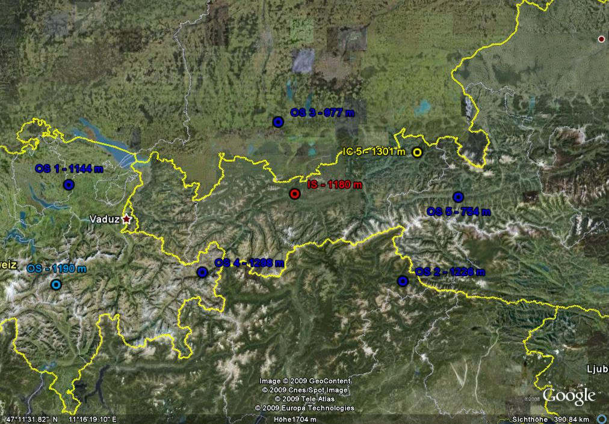
3.2 | Explanations: 3-dimensional (Alpine Seefeld area)

Slide 51
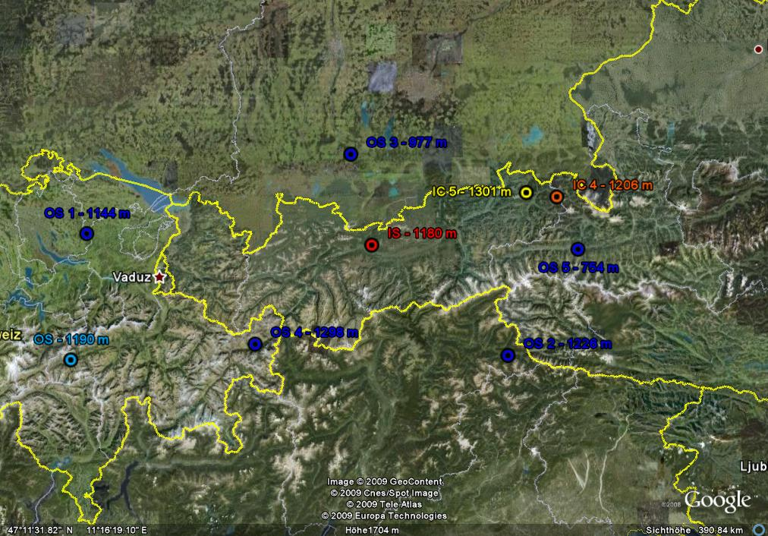
3.2 | Explanations: 3-dimensional (Alpine Seefeld area)

Slide 52
Consideration of all 27 orography descriptors
- Stations Longitude, Latitude, Elevation
- Elevation in 4 scales: 1, 10, 50, 200 km
- Gradient_U(Elevation) in 4 scales
- Gradient_V(Elevation) in 4 scales
- Water in 4 scales: 1, 10, 50, 200 km
- Gradient_U(Water) in 4 scales
- Gradient_V(Water) in 4 scales
3.2 | Explanations: 3-dimensional (Alpine Seefeld area)

Slide 53
TABLE Oro Orography_descriptor id name smooth RepWeight ===== ------------- ----- --------- LocN Loc N .2 centigrad LocE Loc E .2 centigrad LocH Loc elevation .1 meter Elev Elevation 1 0 Elev1 Elevation_1 10 .5 Elev2 Elevation_2 50 0 Elev3 Elevation_3 200 0 GradU Grad_Elev_U 1 0 Gr_U1 Grad_Elev_U_1 10 0 Gr_U2 Grad_Elev_U_2 50 0 Gr_U3 Grad_Elev_U_3 200 .25 GradV Grad_Elev_V 1 0 Gr_V1 Grad_Elev_V_1 10 0 Gr_V2 Grad_Elev_V_2 50 0 Gr_V3 Grad_Elev_V_3 200 .25 Water Water 1 0 Wat1 Water_1 10 .5 Wat2 Water_2 50 0 Wat3 Water_3 200 0 Wa_U Grad_Water_U 1 0 Wa_U1 Grad_Water_U1 10 0 Wa_U2 Grad_Water_U2 50 .5 Wa_U3 Grad_Water_U3 200 0 Wa_V Grad_Water_V 1 0 Wa_V1 Grad_Water_V1 10 0 Wa_V2 Grad_Water_V2 50 .5 Wa_V3 Grad_Water_V3 200 0
3.2 | Explanations: 3-dimensional (Alpine Seefeld area)

Slide 54
Interpolation weights for Toggenburg (NY, US)
Id El 0369...21z method
====== ---- -------- ------
B03503 sN IIIIIIII 1 2 1 2 1 2 1 2 B03503 TTT IIIIIIII 3 B03503 TX12 I_I_I_I_ 3
Id meth Rep Elev_Err Obs-Stations Weights
====== ---- ----- -------- ------------- --------- B03503 1 97.27 -26m 725150 725190 0.62 0.38 B03503 2 94.27 -185m 725190 725130 0.56 0.44 B03503 3 96.85 15m 725150 743700 0.65 0.35 id ICAO nb. el. elev name ====== ---- ------ ------- ---- --------------------------- B03503 42.49 -075.57 381 Toggenburg 725130 KAVP 41.20 -075.44 289 Wilkes-Barre-Scranton PA 725150 KBGM 42.13 -075.59 497 Binghamton NY 725190 KSYR 43.07 -076.07 124 Syracuse NY/Hancock 743700 KGTB 44.03 -075.44 207 Ft.Drum NY/Wheeler-Sack AAF
4.1 | n-dimensional Examples: Representative stations for Toggenburg (NY, US)

Slide 55
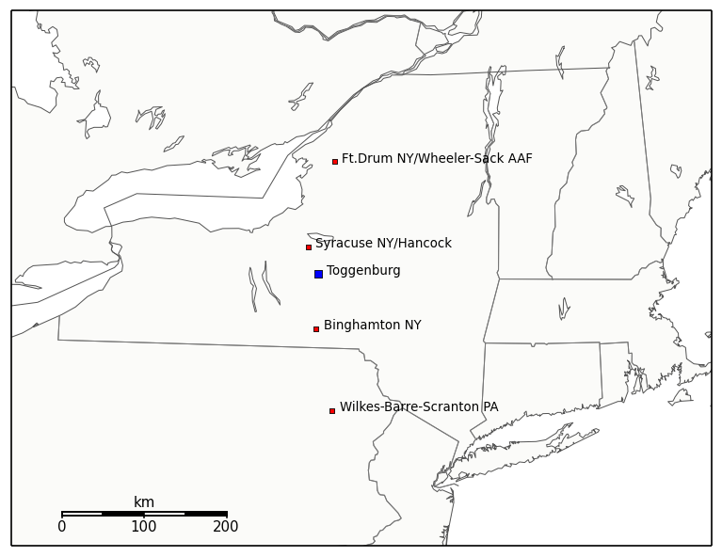
New York
Pennsylvania
4.1 | n-dimensional Examples: Representative stations for Toggenburg (NY, US)

Slide 56
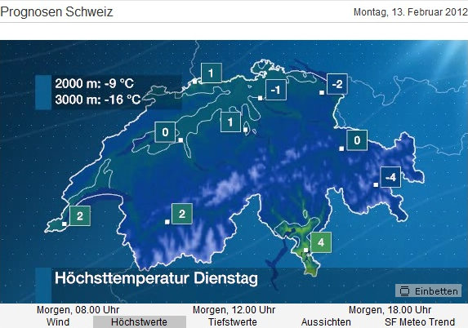
4.2 | n-dimensional Examples: Forecasting examples for 30.000 cities in Switzerland

Slide 57
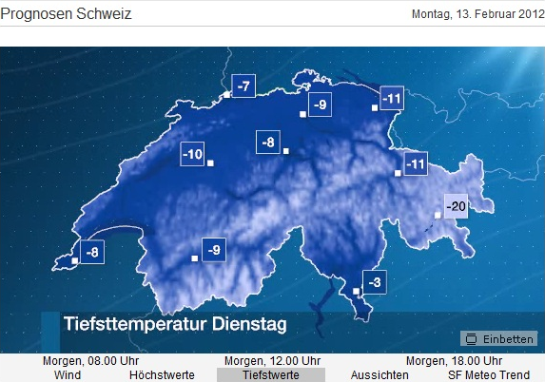
4.2 | n-dimensional Examples: Forecasting examples for 30.000 cities in Switzerland

Slide 58
Forecast Examples from the Seefeld area
Interpolated MOS forecasts for 20-04-2005, 13 UTC
based on the concept of coefficient interpolation outlined above are presented with special emphasis on alpine orography. They are shown with horizontal resolutions of approximately: 70 km, 7 km and 2 km.
Forecast examples for 20-04-2005, 13 UTC
Synoptic Situation:
High pressure in the NNW and Low pressure in the SE, northern flow with precipitation in the northern alps. Snowfall above ~1.000 m, rain below.
4.3 | n-dimensional Examples: Forecasting examples for Alpine Seefeld region

Slide 59
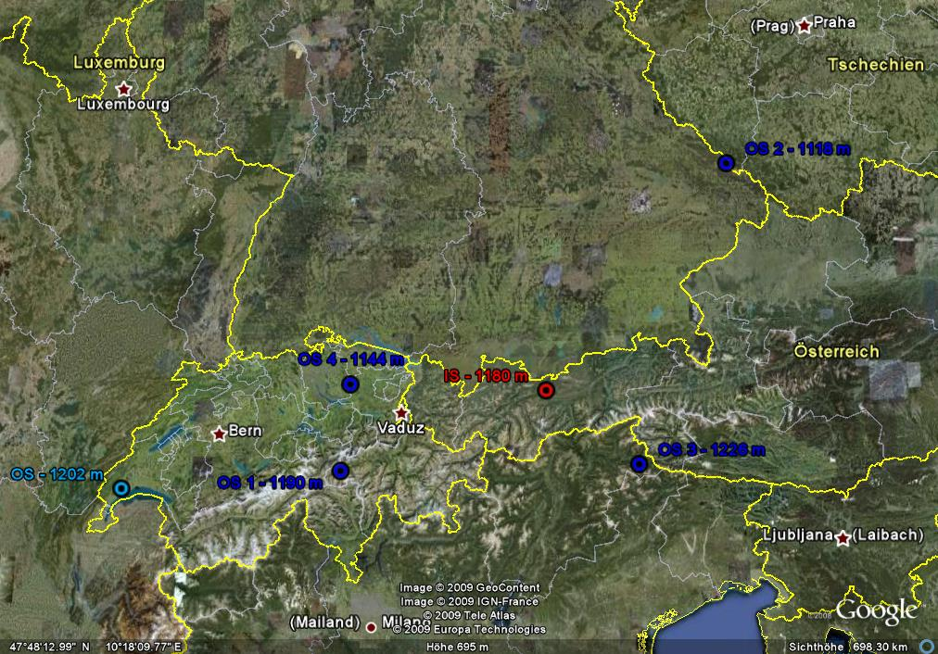
weight
OS 1: 37%
OS 2: 14%
OS 3: 22%
OS 4: 27%
3.2 | Explanations: 3-dimensional (Alpine Seefeld area)

Slide 60
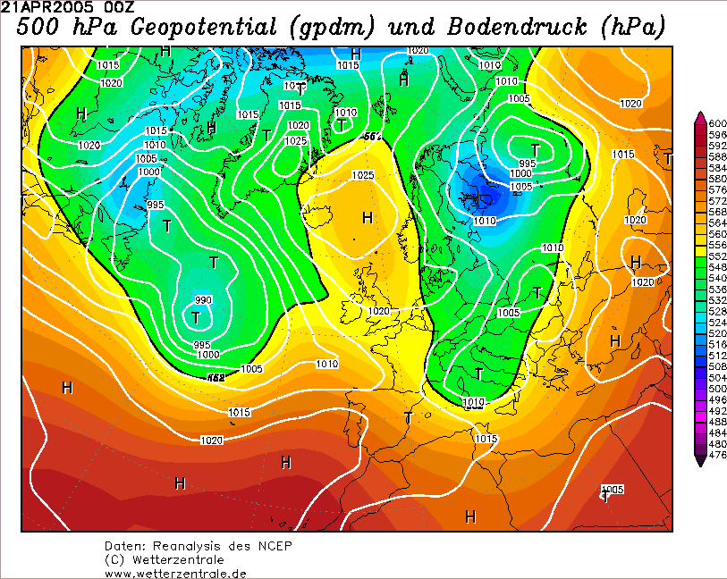
4.3 | n-dimensional Examples: Forecasting examples for Alpine Seefeld region

Slide 61
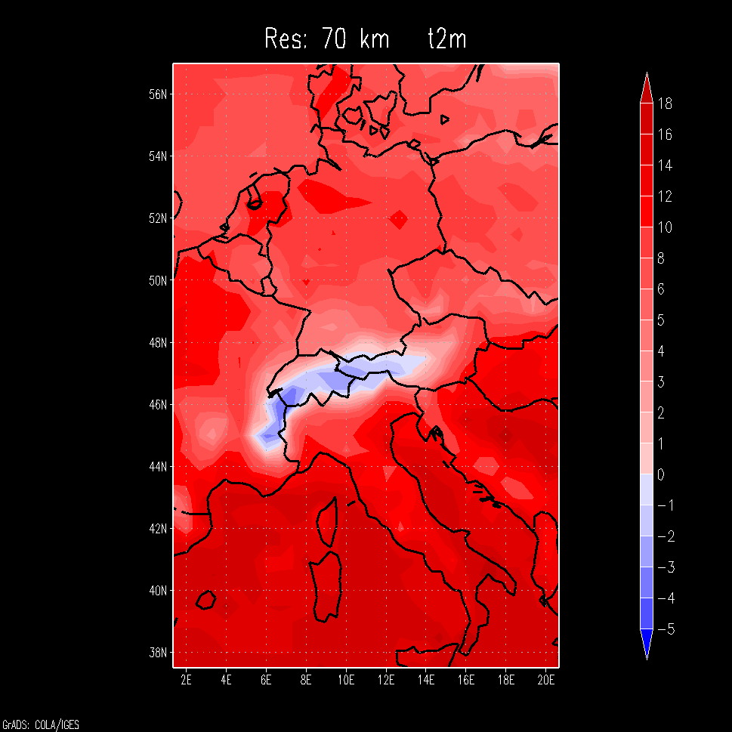
4.3 | n-dimensional Examples: Forecasting examples for Alpine Seefeld region

Slide 62
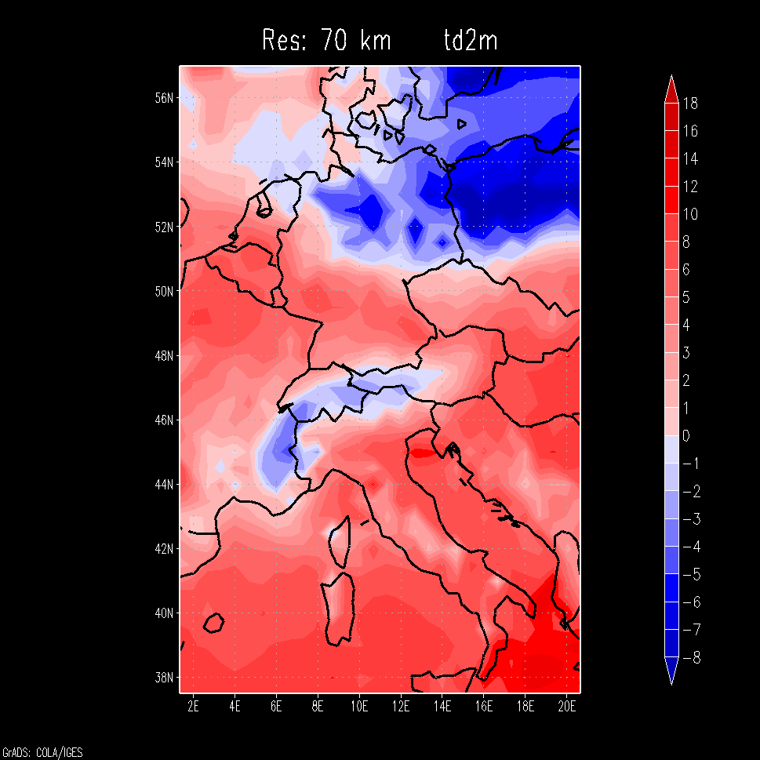
4.3 | n-dimensional Examples: Forecasting examples for Alpine Seefeld region

Slide 63
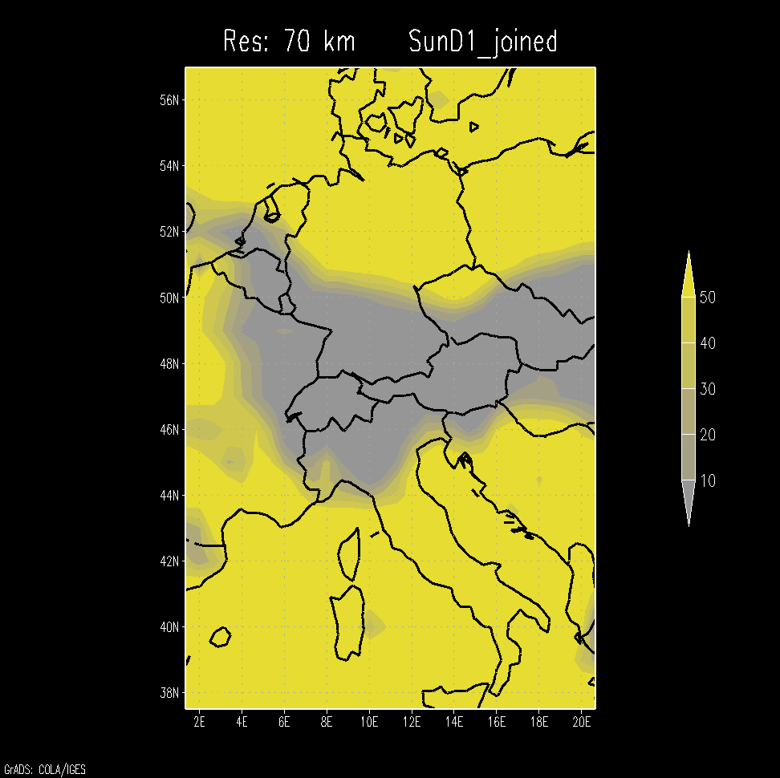
4.3 | n-dimensional Examples: Forecasting examples for Alpine Seefeld region

Slide 64
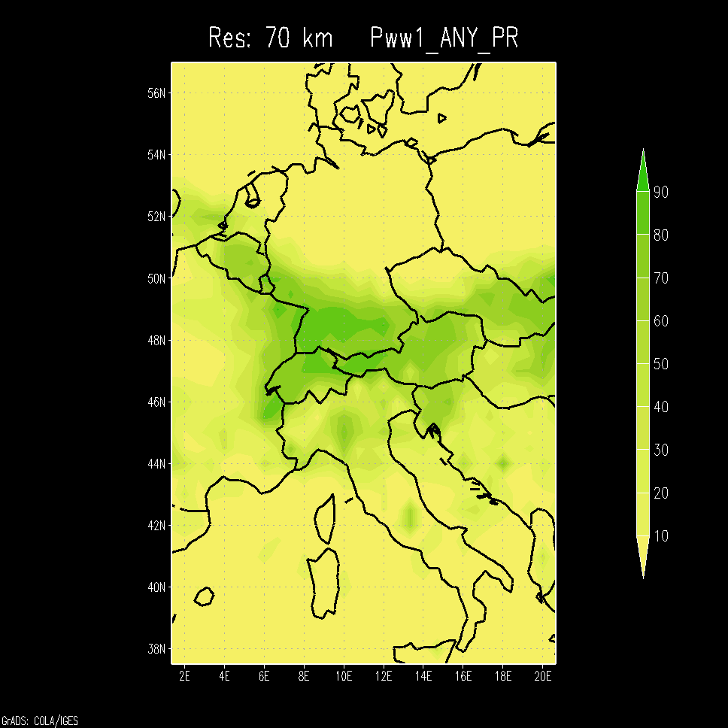
4.3 | n-dimensional Examples: Forecasting examples for Alpine Seefeld region

Slide 65
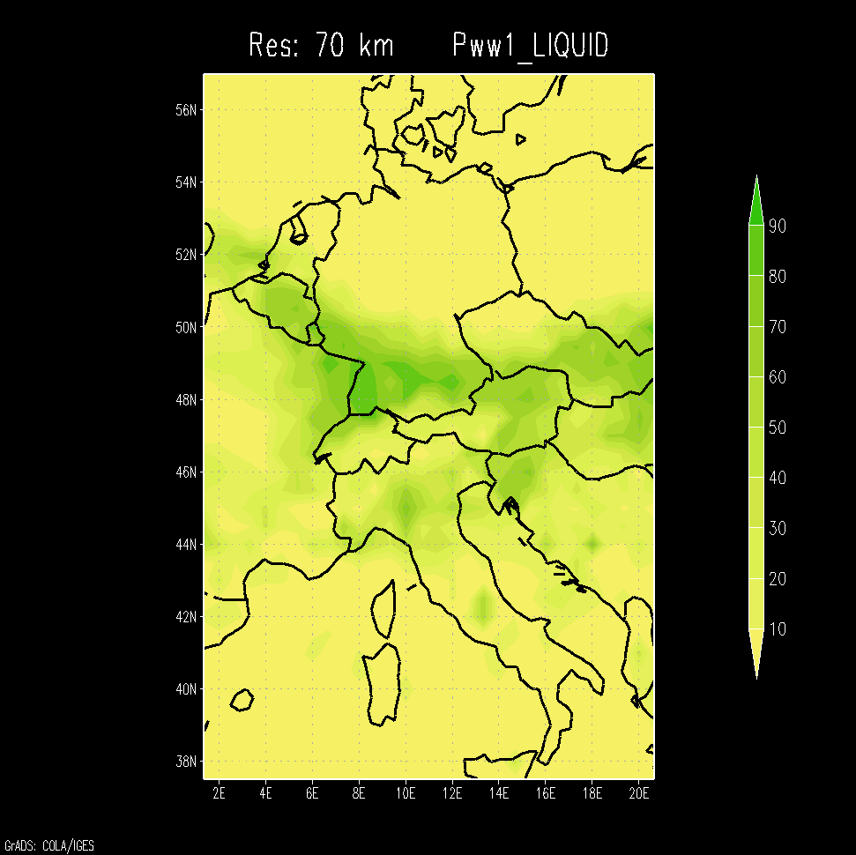
4.3 | n-dimensional Examples: Forecasting examples for Alpine Seefeld region

Slide 66
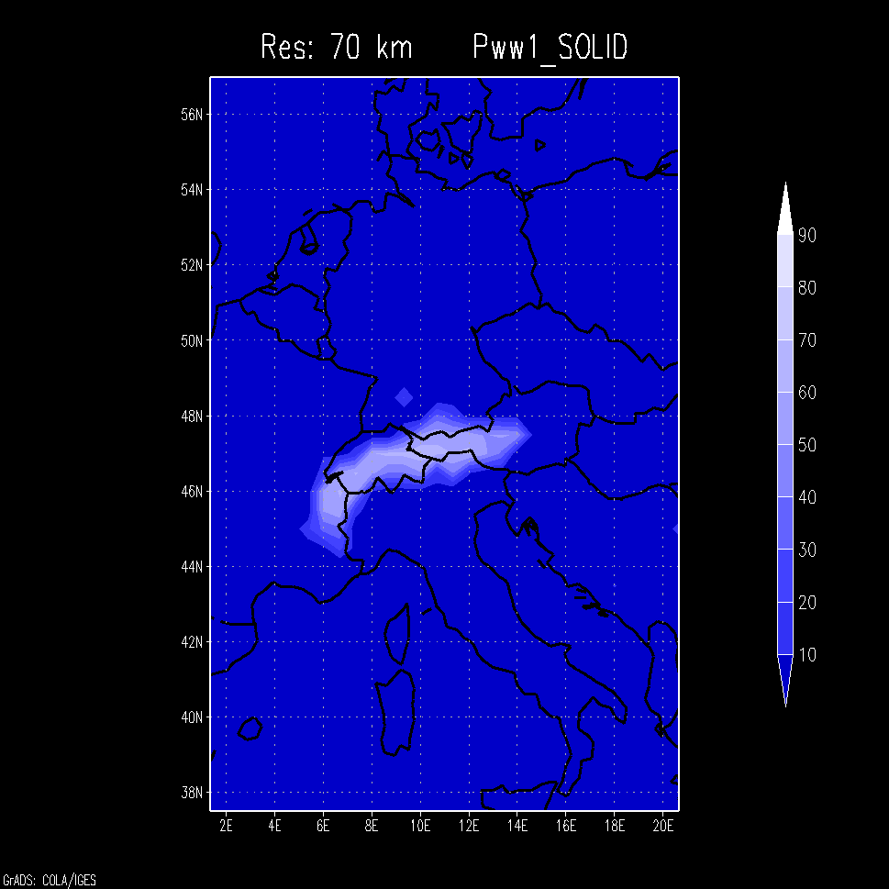
4.3 | n-dimensional Examples: Forecasting examples for Alpine Seefeld region

Slide 67
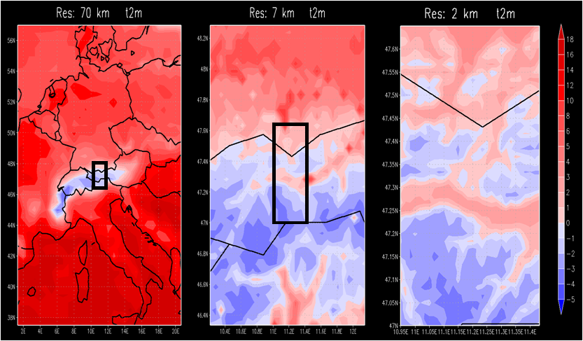
4.3 | n-dimensional Examples: Forecasting examples for Alpine Seefeld region

Slide 68
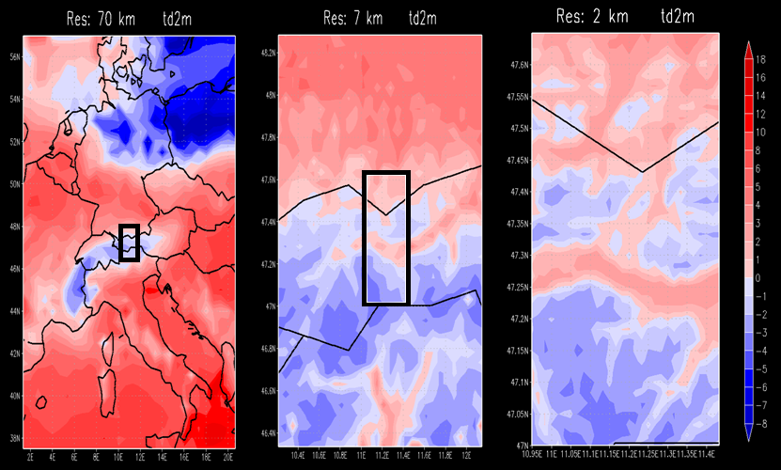
4.3 | n-dimensional Examples: Forecasting examples for Alpine Seefeld region

Slide 69
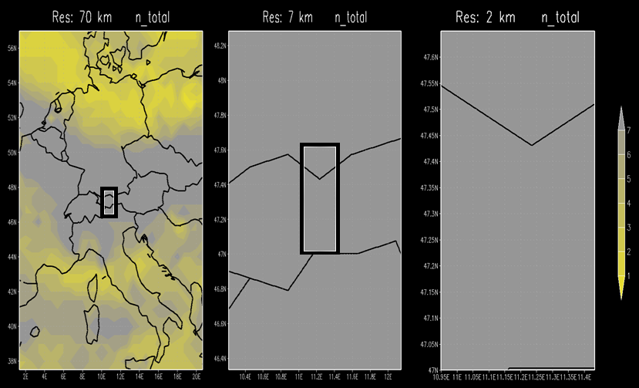
4.3 | n-dimensional Examples: Forecasting examples for Alpine Seefeld region

Slide 70
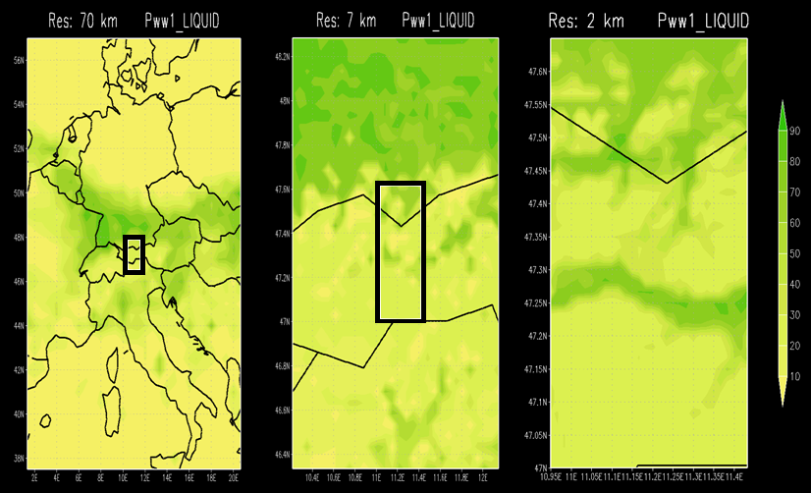
4.3 | n-dimensional Examples: Forecasting examples for Alpine Seefeld region

Slide 71
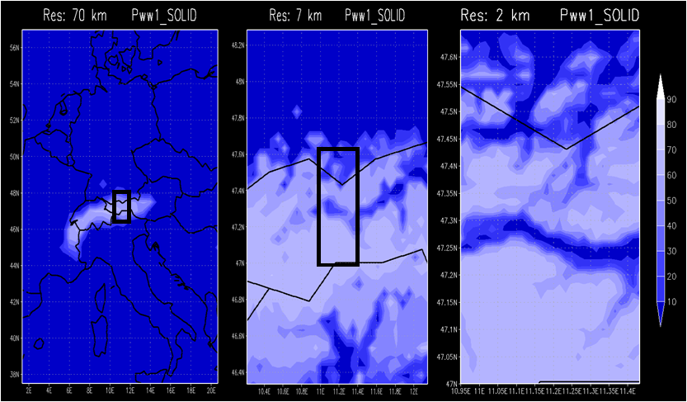
4.3 | n-dimensional Examples: Forecasting examples for Alpine Seefeld region

Slide 72
5.) Verification
Verification based on Kalman-Filter Interpolation from 1994:
Basis of Verification: RV(Kal,MOS) is set to 100%
Out of these 100% remain in Germany after interpolation:
90-100% for Temperatures, cloud cover
50% for wind.
5 | Verification

Slide 73
6. Summary and Outlook
Systematical verifications of the new coefficient interpolation procedure are not present yet but good experiences of
DWD: → for 20 years with the old, verified interpolation scheme → ordered the new scheme. Implementation in winter 2015
- Customers in Switzerland who like these forecasts for 30.000 places based on 200 observing stations. - German Defense Forces: Worldwide Auto-TAF grid-application.
6 | Summary and Outlook

Slide 74
“As you know, I prefer using observations as predictands, even though they are available at a limited number of points. When the analysis of observations is developed to the point that auxiliary data (such as satellite and radar) are used and it can be shown by rigorous tests that the areas between the observations of the elements being analyzed are close to what an observation would have produced, then such analyses could be used as predictand data. However, until auxiliary data are used effectively, I can see no advantage to analyzing the obs and using the analysis as predictand data. It just shifts the burden of analysis to a different place in the process. I am afraid, that because of the NCEP NWP interests, which favor using analyses as predictand data, MOS will become an attempt to produce forecasts of imperfect analyses. One should remember that not only grids are important, but values at specific locations.”
(Bob Glahn, E-Mail 18Oct14)
6 | Summary and Outlook

Slide 75

Thank you for your attention
We welcome your questions, suggestions, comments!
klaus@mswr.de
www.mswr.de

