Slide 1



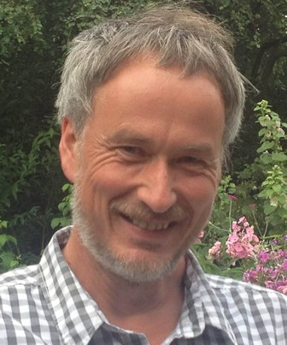
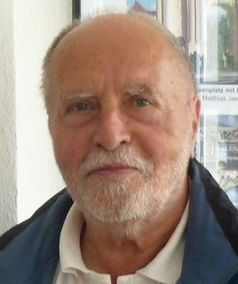

Statistical Interpretation in Germany
the last 50 Years
Klaus Knüpffer
Konrad Balzer
Meteo Service weather research GmbH
Berlin, Germany
Deutscher Wetterdienst (Ret.)
Potsdam, Germany
Phoenix, 06.01.2015, Harry R (Bob) Glahn Symposium

Slide 2

Outline
Statistical Interpretation in Germany – the last 50 Years
1950s
1965
1990
2015
Konrad Balzer
Klaus Knüpffer

Slide 3
1
Konrad Balzer
1950s
1965
2015
1965
During the 1950s the question had been debated:
deductive, dynamic modeling based on laws of physics or
inductive, statistical approach
Today we know: The answer is and, not or.

Slide 4
1
Konrad Balzer
1950s
1965
2015
Some (West) German voices
H. Flohn (Meeting of (West) German Met. Society in Garmisch-Partenkirchen):
- Proposed development of objective-statistical methods of point prediction based on predicted upper troposphere weather maps.
H. Flohn (Meeting of German Met. Society in Berlin(West)):
- coupling of statistical and theoretical approaches is promising
1953
1955
1958
W. Schwerdtfeger (Met. Rundschau, 1955, p 59f):
- It is essential to put statistical research aside the numerical research
Notes:
4

Slide 5
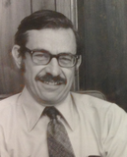
1
Konrad Balzer
1950s
1965
2015
Former East Germany (the 60s)
W. Böhme (Meeting of Met. Society of East Germany):
- statistical entropy as a measure for uncertainty of prognostic statements reaches a minimum at a certain combination of statistical and numerical techniques.
If a forecaster uses a method which is based on laws of atmospheric dynamics then his disadvantage against the machine is that the machine considers these laws in a more comprehensive way. If, however, a forecaster relies more on certain rules then his disadvantage against the objective statistical procedures is related to insufficiencies of human memory (Böhme, 1969).
Foundation of the group 'Synoptical Research' at the Central Weather Forecasting Office of East Germany, Potsdam: H. Maede, M. Buttenberg, K. Balzer (since 1967): → Since 1970: real time medium range forecasts based on analogous cases using geopot. height 500 hPa : AF.
W. Böhme: 'Head of former East German Natl. Weather Service'
1963
1966
1969
W.H. Klein: Objective Forecasts of Surface Temperature for one to three days in advance (J. Appl. Meteor., 5, 137-147): First operational Perfect Prog system

Slide 6
1
Konrad Balzer
1950s
1965
2015
Former East Germany (the 60s)
W. Böhme: 'Head of former East German Natl. Weather Service': If a forecaster uses a method which is based on laws of atmospheric dynamics then his disadvantage against the machine is that the machine considers these laws in a more comprehensive way. If, however, a forecaster relies more on certain rules then his disadvantage against the objective statistical procedures is related to insufficiencies of human memory.
W. Böhme (Meeting of Met. Society of East Germany):
- statistical entropy as a measure for uncertainty of prognostic statements reaches a minimum at a certain combination of statistical and numerical techniques.
Foundation of the group 'Synoptical Research' at the Central Weather Forecasting Office of East Germany, Potsdam: H. Maede, M. Buttenberg, K. Balzer (since 1967): → Since 1970: real time medium range forecasts based on analogous cases using geopot. height 500 hPa : AF.
1963
1966
1969
W.H. Klein: Objective Forecasts of Surface Temperature for one to three days in advance (J. Appl. Meteor., 5, 137-147): First operational Perfect Prog system

Slide 7
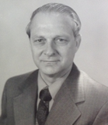
1
Konrad Balzer
1950s
1965
2015
1. WMO Symposion on Statistical Interpretation of Broad Scale NWP Products into Local Weather Elements. Spiritus Rector: L. Bengtsson.
K. Balzer became more and more philosophical head of the 'Synoptic Research' group and my major intellectual guide.
Automated production and verification of AF forecasts
1970
1972
1976
1980s
Glahn & Lowry: The use of Model Output Statistics in objective weather forecasting: J. Appl. Meteor., 11, 1203-1211
I studied Meteorology at Humboldt University Berlin, was operational forecaster for 3 years at the Central Weather Forecasting Office of East Germany, Potsdam and developed a scheme how in an ideal weather forecasting system would look like in an ideal world (that is one with unlimited computing power).

Slide 8

2
Klaus Knüpffer
1950s
1965
2015
there was no statistical weather forecasting system in operation at Deutscher Wetterdienst (German Natl. Weather Service) DWD
→ DWD overtook AFREG-Mix (analog cases + regression, multi model mix) from K. Balzer. He was responsible then also for verification at DWD. His work became inspired by the work of A. Murphy.
K. Knüpffer and D. Haalman: founded Meteo Service weather research GmbH instead
specialized in all aspects of MOS
provides MOS services worldwide, based on the GFS model (and subsequent others), for any interested customer
1. ECAM (European Conference on Applications of Meteorology)
1989
1990
1993
1994
THE WALL CAME DOWN
I used my first opportunity to visit Bob Glahn at TDL in summer of 1990. I appreciated Bob's kindness and hospitality from the very first meeting which was followed by more visits later in the 1990s.
My proposal to affiliate a 'European Centre for Statistical Post-Processing' to ECMWF was encouraged
by the idea of TDL and
by success of his first MOS system (developed for the private Dutch company Meteo Consult Wageningen (now: Meteo Group)
unfortunately this proposal was in vain

Slide 9
2
Klaus Knüpffer
1950s
1965
2015
1999

Slide 10
2
Klaus Knüpffer
1950s
1965
2015
2010
MSwr-MOS applications
Standard weather element forecasts
Aviation Auto-TAF: Globally, gridded, based on MOS coefficient interpolation
NowCast applications
  Radar and lightning MOS, CellMOS, WarnMOS
Wind and solar energy forecast
Water level forecasts

Slide 11
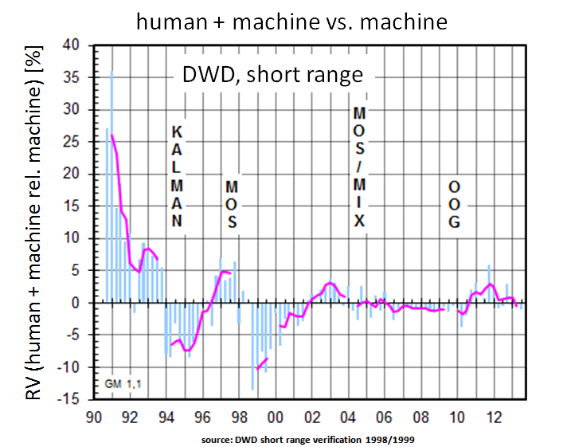
2
Klaus Knüpffer
1950s
1965
2015
©P. Lorenz

Slide 12
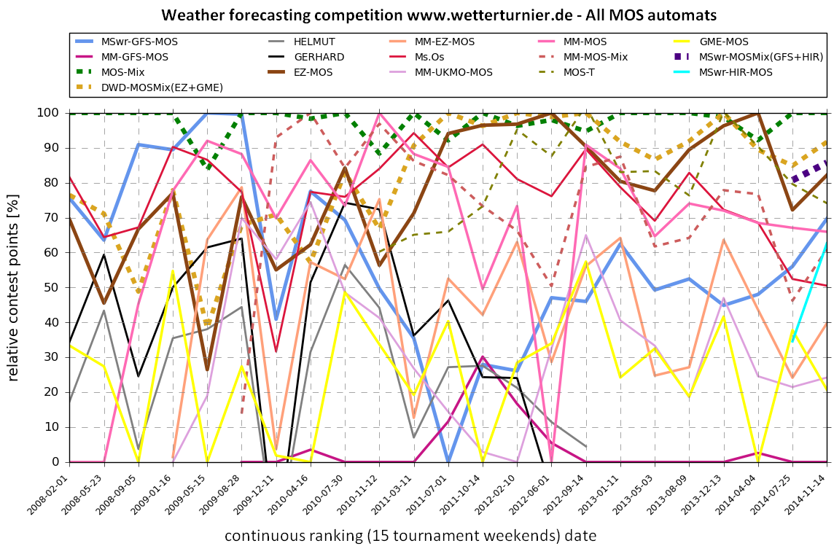
2
Klaus Knüpffer
1950s
1965
2015
©P. Lorenz

Slide 13
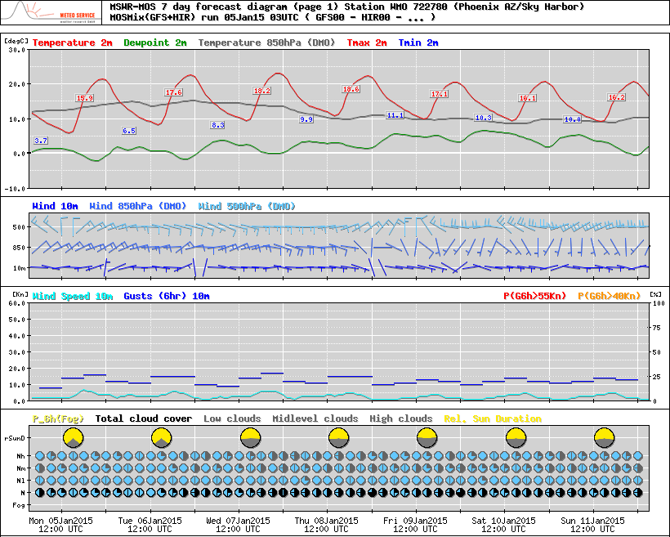
2
Klaus Knüpffer
1950s
1965
2015
MSwr-MOS forecast diagram Phoenix, 06Jan15
©P. Lorenz

Slide 14
2
Klaus Knüpffer
Bob once asked how a three-man company can do all this MOS stuff. One answer is:
Only general solutions which work for all elements (or at least classes of elements) are used and
high level informatics designed by D. Haalman developed 20 years ago

Slide 15
2
Klaus Knüpffer
Last but not least: MOS is a perfect way to combine all the valuable
predictive information we gather
The better the numerical models the better the MOS, and the better
the MOS the better the final forecaster
Co-operation between these three system components is the key
Comparative verification and competitions are powerful tools to
explore strengths and weaknesses of the components, with the goal to
further optimize the forecasting systems
We always think of Bob with gratitude, for the important milestones
he has accomplished, to push our community further into that direction

Slide 16
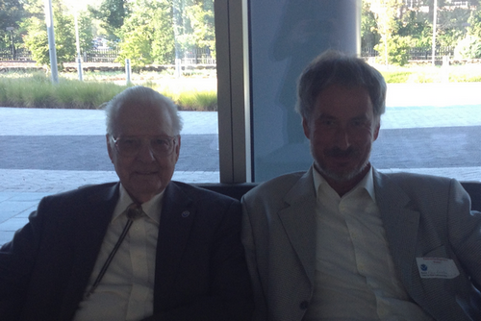
2
Klaus Knüpffer
Bob, ever shining diamond, we wish you a long life, in the dark room - keeping beating ghosts off – and outside: Always among the ones who honest you and who love you.
Notes:
16

Slide 17
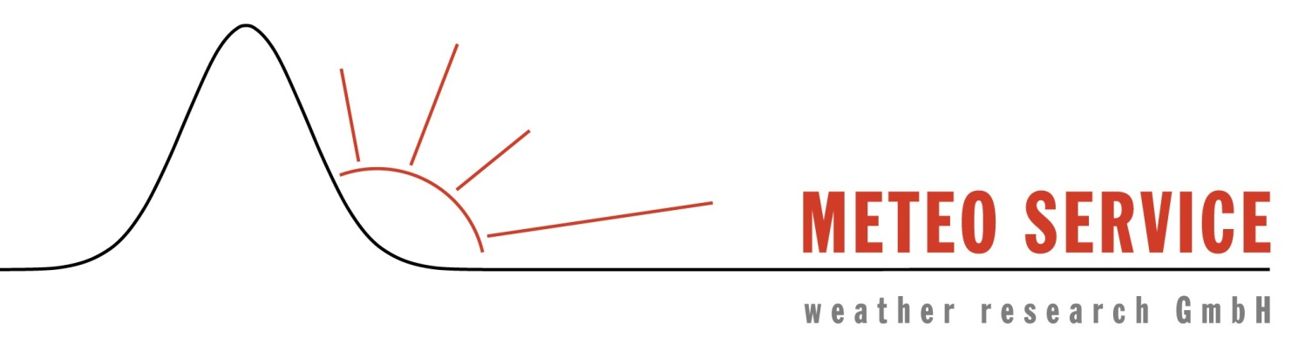

Thank you for your attention
We welcome your questions, suggestions, comments!
klaus@mswr.de
www.mswr.de
konrad.balzer@gmx.de

